Slide 1





International Transport Energy Modeling (ITEM) Forum
Summary of Workshop held on October 2014 and next steps
Gouri Shankar Mishra & Lew Fulton
University of California, Davis
May 13, 2015

Slide 2
Project Status
Began as a voluntary effort to compare models and projections
IEA Mobility Model (MoMo)
PNNL GCAM Model
ICCT Roadmap Model
IIASA Message Model
Conducted a workshop to present each model and do a round of comparisons on October 2nd, 2014
Have recently received funding from DOE/ORNL to more fully develop the project and compile a Phase I Report on models, projections and data issues.
Co-funding with STEPS consortium funding
Will cover a range of topics but particular emphasis on vehicle ownership, travel, and technology/fuel
Report by October 2015

Slide 3




Estimates of global fuel consumption in 2040: 145 to 200+ EJ
Projections
Note: All energy estimates are in LHV
3

Slide 4
Baselines projections of alternative fuel consumption: Share of alternative fuels rises from around 5-7% in 2010 to 7-12% of total transportation fuel
Projections
Note: All energy estimates are in LHV
4

Slide 5
Insight (1)
iTEM Models are different
Differences across multiple dimensions
Model Structure
Regional disaggregation
Sectorial Coverage
Solution Mechanism
….

Slide 6
Insight (1)
Differences in Sectorial coverage
Varying accounting systems for biofuel CO2 emissions attributed to transportation sector

Slide 7
Insight (1): iTEM models estimate ownership rates and parc (stock) in fundamentally different ways
Socio
Owner-ship Costs
Preferences
Load Factor
VKT/year
Survival Curves
Roadmap
Mobility (PKT)
Mobility Mode
Shares
LDV / 2W VKT
LDV / 2W Parc
LDV / 2W Sales
Socio
G. User Cost
Preferences
Load Factor
VKT/year
Survival Curves
GCAM
MESSAGE
Mobility (PKT)
Mobility Mode
Shares
LDV / 2W VKT
LDV / 2W Parc
LDV / 2W Sales
Socio
VKT/year
LDV / 2W VKT
Mobility (PKT)
LDV / 2W Ownership Rate
LDV / 2W Parc
MoMo
Load Factor
LDV / 2W Sales
Survival Curves

Slide 8
Insight (2)
Large Differences in Historical Data:
Considerable differences in historical data, both globally and for individual countries (particularly non-OECD countries).
Variability in estimates of transportation activity are in most cases much larger than energy differences.

Slide 9
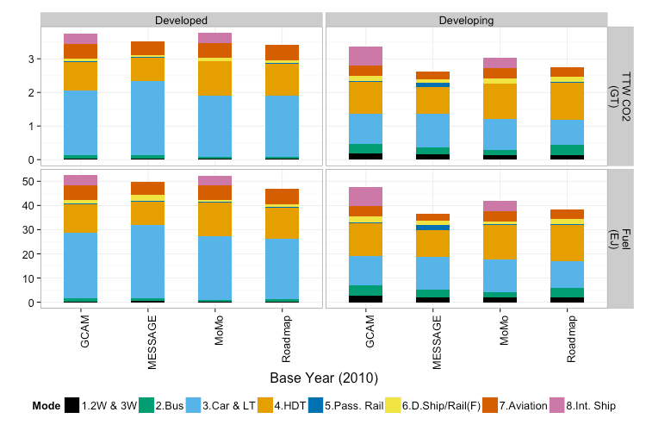
Insight (2) Large Differences in Historical Data:
Note: All energy estimates are in LHV
Note: Roadmap & MESSAGE Shipping not included

Slide 10
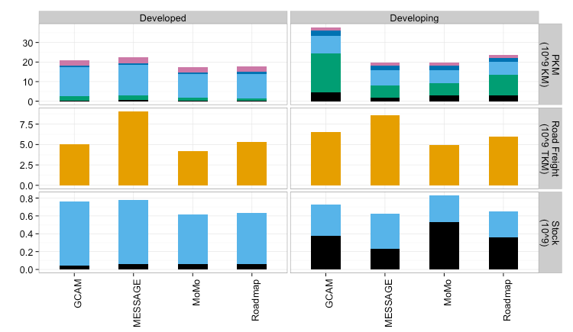
Insight (2) Large Differences in Historical Data:

Slide 11
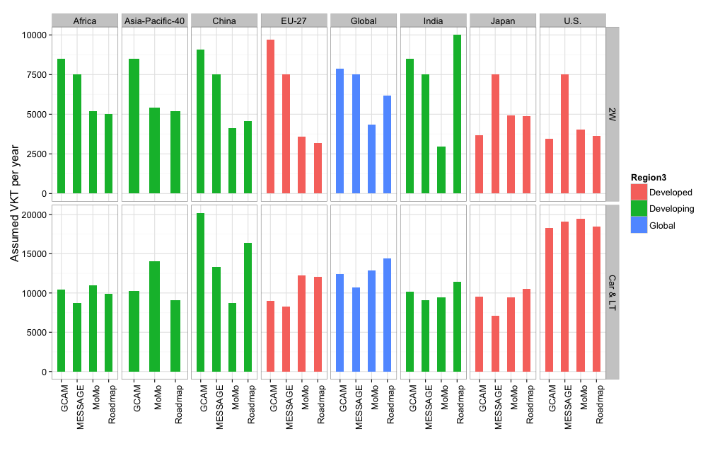
Insight (2) EXAMPLE: Differences in assumed annual VKT/year

Slide 12
Insight (3)
Projections of personal vehicles ownership rates by 2050:
Global average : 270 to 450 per 1,000 people
U.S. :700 – 1,075 (~700 today)
China :100 – 650
India: : 80 – 380

Slide 13
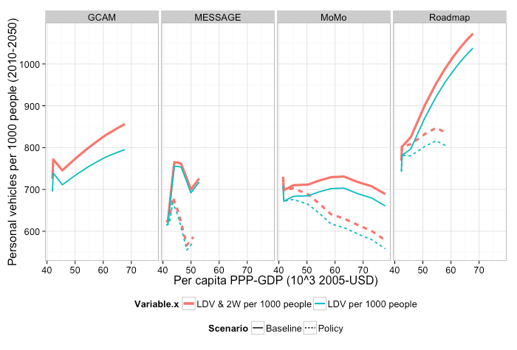
U.S.
Insight (3): LDV and 2W ownership rates (2005 – 2050) – U.S.
US

Slide 14
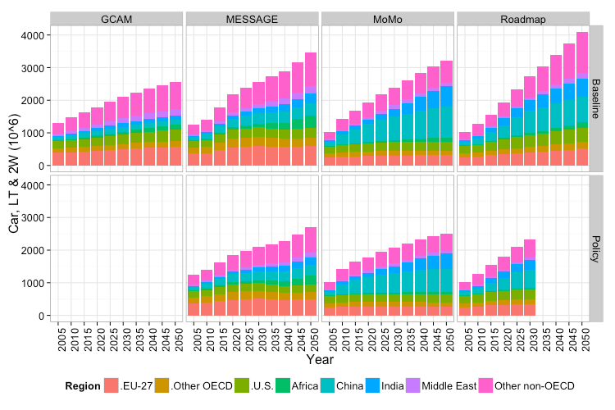
Insight (3) Global Stock of 4W and 2W

Slide 15
Insight (4)
Current policy commitments may not meet stringent climate targets:
Current policy commitments toward EVs, PHEVs and H2FCVs (and thus baseline projections) maybe below the numbers suggested by iTEM models as required for meeting climate targets (e.g., 2°C).

Slide 16
Insight (4): Model projections and existing mandates

Slide 17
Insight (5) : Research priorities

Slide 18
EXTRAS

Slide 19
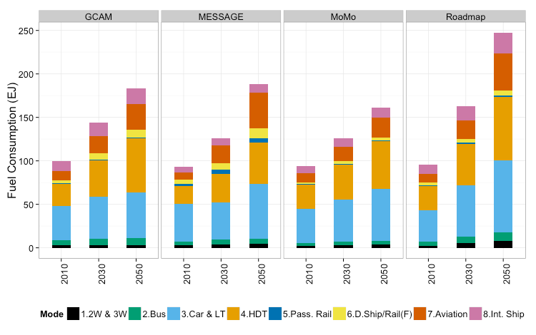
Fuel consumption projected to grow by 1.75x to 2.5x by 2050
Projections
Growth rate
2010-2050
158%
83%
100%
72%
19

Slide 20
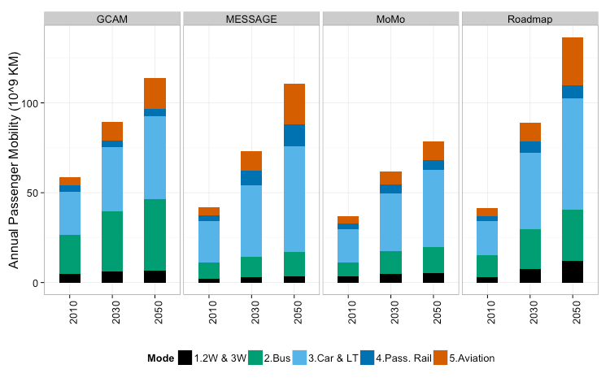
Passenger mobility projected to grow by 2x – 3x with aviation growing the fastest
Projections
Growth rate
2010-2050
229%
94%
163%
112%
Per capita travel graph in Appendix

Slide 21

Model Comparison: Drivers and Feedback

