Slide 1
Dynamic Ridesharing: An Exploration of the Potential for Vehicle Miles Traveled and Greenhouse Gas Reductions
Caroline Rodier, Ph.D.
Associate Director, ULTRANS
May 13, 2015

Slide 2
Acknowledgments
Co-Authors: Farzad Alemi & Dylan Smith
Thank You to Our Funders!
Mineta Transportation Institute
California Department of Transportation
Honda Endowment
Sustainable Transportation Energy Pathways

Slide 3
Introduction
New vehicle & fuel technology necessary, but not sufficient, to meet GHG goals
Demand management strategies (land use, transit & auto pricing) also needed
More recently, newly introduced dynamic ridesharing systems also shows promise
However, there is very little research on potential travel effects, especially at a regional scale.
Notes:
Deep GHG goals
Such as LU, Transit, and Auto Pricing—also needed to reduce VMT and reduce GHGs
DRS also shows promise to reduce VMT/GHGs
New travel mode at new travel time & cost price points to many travel destinations.
Complex & inter-related system level effects, both positive & negative, on congestion, VMTs & GHGs.

Slide 4
Study: Case and Questions
San Francisco Bay Area Activity Based Travel Model (2010)
What is the potential magnitude VMT reduction from dynamic ridesharing?
How might land use, transit, and auto pricing interact with these services and change VMT/GHG reductions?
Notes:
In this study, we used the SF Bay Area regional or Metropolitan Transportation Commissions’ (MTC) ABM for the year 2010, to explore two questions:

Slide 5
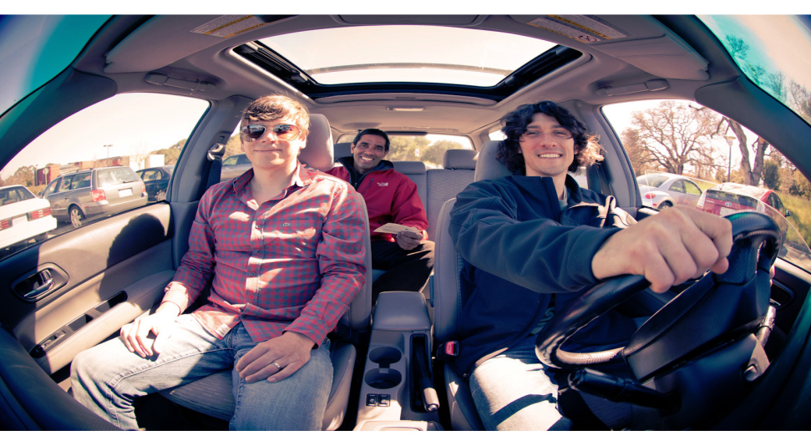
Dynamic Ridesharing
Automatically matches drivers & riders with similar spatial & temporal constraints
Communicates match in advance or on demand (e.g., 15 to 60 seconds)
Smart phone application
Notes:
Next I am going to provide you with a brief overview of dynamic ridesharing services
These services automatically match drivers and riders with similar spatial and temporal constraints (i.e., trip origin/destination locations and departure/arrival times).
They communicate matches to service participants upon request in advance or on demand in real time (in as little as 15 to 60 seconds).
The services also provides smart phone applications to participants

Slide 6
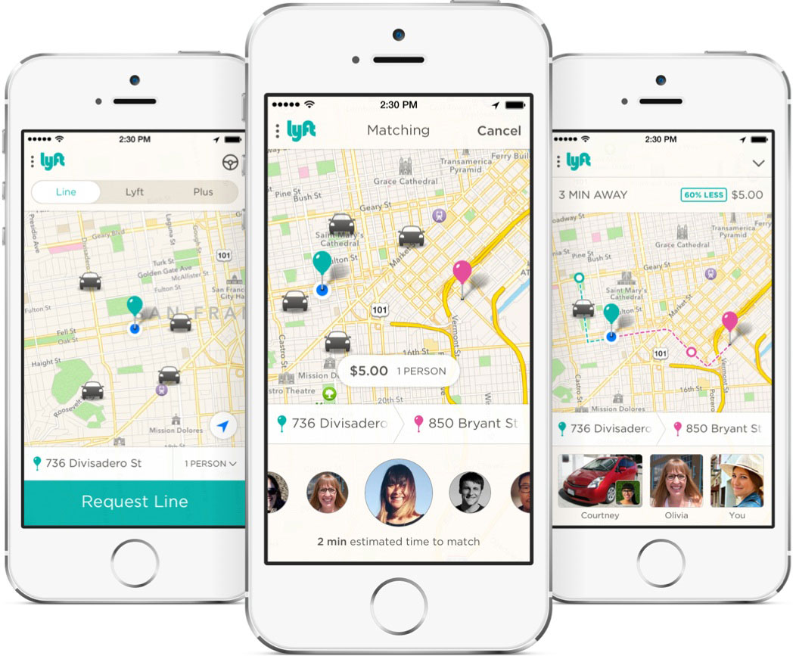
Smart Phone App: Lyft Line
Notes:
This is an example of Lyft Lines’ Smart phone application
It allows users to request matches
View ratings and evaluate drivers and riders
Accept or reject matches, and
Pay drivers

Slide 7
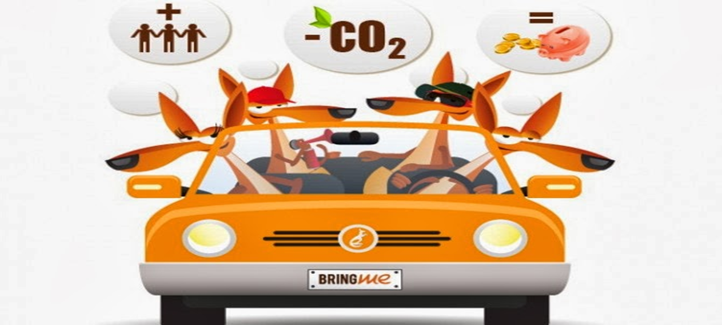
Peer-to-Peer Model
Zimride & Carma
Driver’s car
Rider fee:
Reimburse cost
Entity pays
Driver shares with operator
Notes:
There two general ridesharing model types, the first is peer-to-peer ridesharing
Examples of this model include Zimride and Carma
Drivers use their own car
Riders pay drivers a fee, which is supposed to reimburse costs, or a flat fee is paid by an entity (e.g., university or business) to use the service

Slide 8
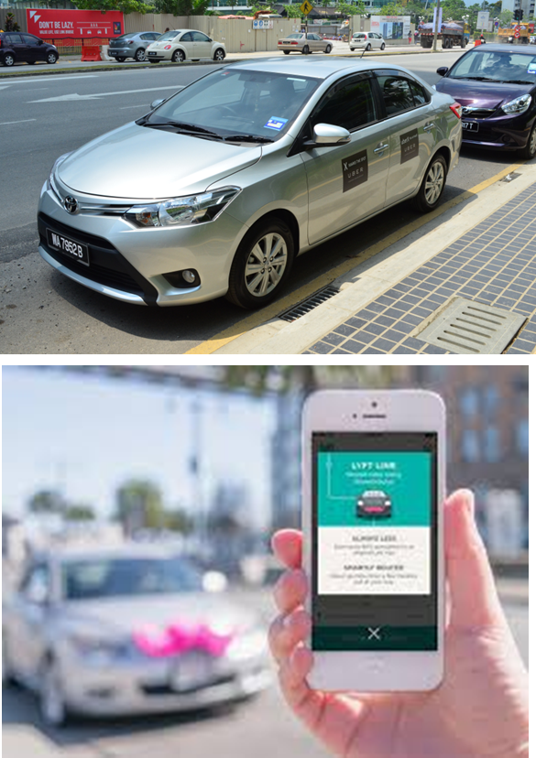
Taxi-Sharing Model
UberX & Lyft Line
Drivers licensed taxi drivers or independent contractors
Rider fees shared by driver & operator
Notes:
The second model is taxi-sharing
Examples of the taxi-sharing model include UberX and Lyft Line
Drivers can be licensed taxi drivers or independent contractors
Riders pay a fee, which is shared by the driver and operator

Slide 9
Literature Review
Atlanta (GA), AM commute VMT reduced by 25% with low participation rates (2%) (Agatz et al., 2011)
Austin (TX), daily VMT reduced by 10% when automated vehicles use a shared use vehicle operational model (Fagnant and Kockelman, 2015)
Both studies fix travel demand in their simulations, i.e., don’t represent induced travel effects and thus may over-estimate VMT reductions
Notes:
There very few studies that evaluate potential environmental travel benefits from dynamic ridesharing
There are two studies that use a trip based travel demand model to evaluate ridesharing type service at a regional level

Slide 10
Scenarios
TOD: + 20%, 30%, 50% residential density
VMT Fee: + 10%, 30%, 50% auto operating cost
Dynamic Peer-to-Peer Ridesharing (DRS):
Variable | Low | High
Participation | 50% | 100%
Trip Length | 10 mi. | 5 mi.
Proximity | 5 mi. | 15 mi.
Flexibility | 30 min | 60 min
Notes:
As discussed above, this study uses the SF Bay Area Activity Based Model or ABM for the year 2010 to simulate
Since dynamic ride sharing is so new, little is known about the influence of dynamic ridesharing service characteristics on use of the service.
As a result, we identified a number of ridesharing conditions with externally specified values.
We do not simulate the barriers and incentives for ridesharing use. This is for future research.
In this analysis, we simulate relatively high and low ridesharing use scenarios that assume travelers will only use ridesharing
(a) for trips that are greater than 10 or 5 miles long
(b) for trips origin locations between 5 or 15 miles
(c) for trips with departure time windows within 30 or 60 minutes
+Given these the trip length, proximity, and flexibility parameters are met, only 50 or 100 of those who could use ridesharing actually do use it.

Slide 11
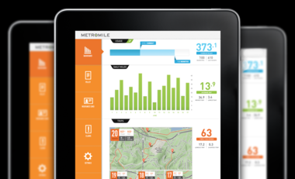
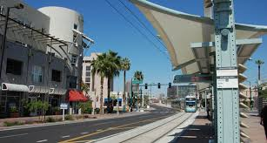
VMT/GHG Effects
Land Use & Transit (TOD) Modest Effects
↓1.3% to 3.2% from business-as-usual (base case)
Pricing (VMT Fee) Most Effective at High Levels
Politically Difficult to Implement
Notes:
In general, the literature indicates that land use and transit scenarios have relatively modest effects on VMT, percentage reduction in VMT ranges from 1.3 to 3.2 percent from a BAU scenarios
Auto pricing policies have a stronger effects, particularly at high price levels
However, it is generally acknowledged that both are politically difficult to implement

Slide 12
TOD & VMT Fee: % Change in Daily SF Bay Area 2010 VMT from Base
Notes:
These are the results from the SF Bay Area model for the TOD and VMT fee scenario—they are consistent with the literature.
Most reduction in VMT for TOD scenario and larger reductions for the VMT scenarios
Two lines for each scenario, one includes short run and the other long run elasticity of VMT with respect to average vehicle travel speed to avoid overestimating VMT reductions

Slide 13
Dynamic Ridesharing, TOD & VMT Fee:
% Change Daily SF Bay Area 2010 VMT
Notes:
This slide shows the VMT effects of dynamic ridesharing added to the base case scenario or the DRS scenario
The relatively low to high use range for dynamic ridesharing in this study reduces VMT on the order to 9% to 25%, which is a relatively large reduction, compared to the effectiveness of other demand management strategies.

Slide 14
Dynamic Ridesharing & Base, TOD & VMT Fee:
% Change in Daily Ride-Shareable Trips
Notes:
In this slide, we see the results of dynamic ridesharing added to the base, TOD, and VMT scenario
The results are for ride-sharable trips– these are trips that could be shared as specified by scenario conditions if travelers decide to participate or join the ride-share—the potential rideshare market is sizable ---percentage change on the order of 12 to 33% from the base.
We see smaller increases in ride-sharable trips in the TOD scenarios and larger increases in the VMT fee scenarios
Results vary with the effectiveness of the VMT fee policies and increased proximity of origin and destination locations with shorter trips that results from this scenario

Slide 15
Dynamic Ridesharing+Base, TOD & VMT Fee: % Change Daily Average Weighted Speed
Notes:
Weighted average speed as a measure in change in average travel time by time of day weighted by number of trips in a time period.
Increases are on the order to 3% to 8%.
There is not much change at the higher levels of ridesharing for the scenarios
More change for VMT fee scenarios at lower levels of ridesharing

Slide 16
Dynamic Ridesharing+Base, TOD & VMT Fee:
% Change Daily Long Run VMT
Notes:
Long Run VMT reductions
VMT reductions on the order of 9% to 30%.
VMT fees plus dynamic ridesharing produce significant reductions in VMT—again compared to other demand management policies.

Slide 17
Conclusions
Relatively large VMT reductions possible from ubiquitous dynamic ridesharing at regional level:
Relatively low levels 10% reduction in VMT
Higher levels 25% reduction in VMT
Combined ridesharing with TODs & VMT Fee suggest more feasible policy options:
A moderately used regional dynamic ridesharing with 10% increase in VMT fees may produce reductions in VMT on the order 12%

Slide 18
Future Research: Dynamic Ridesharing
Factors Associated with Higher Use
Individual Attributes
Characteristics of Tours and Trips
Time and Cost Benefits
Modeling Travel Effects More Explicitly
Auto Ownership
Mode Choice
Destination Choice
VMT from Taxi-Sharing
Notes:
This may be particularly important for improved analysis of TOD effects

Slide 19
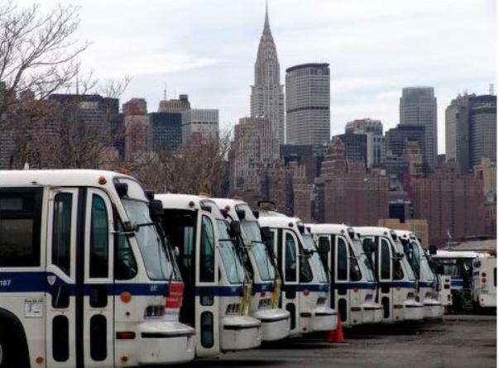
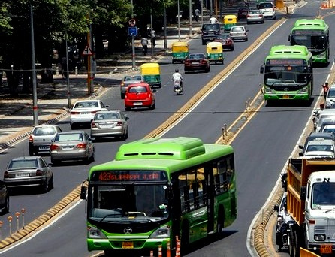
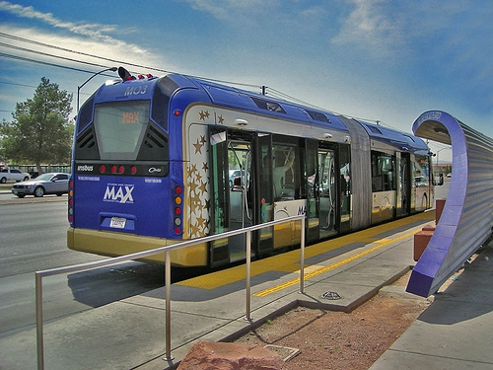
For any question, please contact:
Caroline Rodier, Ph.D.
Urban Land Use and Transportation Center
University of California, Davis
e-mail: cjrodier@ucdavis.edu
Notes:
This is achieved by applying elasticities of VMT with respect to travel speed from the literature. LR (.64) and SR (0.3)
If a scenario reduces average travel speed in one or more time periods then these elasticities figures are applied to represent how travel might increase in response to faster travel times.
Given the potential for significant reductions in speed, it is important to represent induced travel to avoid overestimating VMT reductions.
+Both low and high assume that at least 50% trips within a tour must be ride-sharable for a person to rideshare (trips per tour) and there may be no more than 6 stops in a tour for a tour to be considered eligible for ridesharing (max tour stops)
Land use and transit scenarios (or TODs) in which residential density around transit stations was increased by 20%, 30% & 50% relative to the business as usual scenario or base case 0.5% HH/Pop, 0.8 HH/Pop, 1.5 HH/Pop
The auto pricing policy is an increase in the per mile cost of driving from about 18 cents in the base case to 25, 40, and 55 cents
In response to these generated pressures, Assembly Bill 32 (AB32), the Global Warming Solution Act of 2006, was passed by the California legislature and signed by Governor Schwarzenegger. According to AB 32, the State of California is required to reduce GHG
emissions to 1990 levels by 2020. The Governor’s Executive Order (S-3-05) targets an additional 80% reduction in GHG emissions below 1990 levels by 2050. To achieve these goals, several policy packages have been passed since 2006. Lower carbon fuel, higher fuel efficiency, and a zero emission vehicle mandate have targeted transportation technology. Yet, despite advances in these areas, CO2 emissions from the transportation sector will continue to rise if travel demand (in particular, the use of single-occupancy vehicles) and the distances between land uses do not decrease. As SB 375 Section 1 article c states, “… Without significant changes in land use and
transportation policy, California will not be able to achieve the goals of AB 32
Promising big savings, a new startup called MetroMile on Wednesday announced a new type of car insurance aimed at commuters who don’t really use their cars all that much.

Slide 20
Notes:
This slide illustrates the potential trade-off between the time and monetary costs of dynamic ridesharing and taxi type services (regular, Lyft and sidecar). In this small sample, ride sharing is cheaper but not as fast, with a couple of exceptions.

