Slide 1
Travel Data and the Smartphone: Building an International Travel Dataset One Android User at a Time
Gil Tal
Michael Nicholas
Matthew Favetti

Slide 2
Data Collection Tools on Travel Behavior and Motivations
Why?
GPS data and Motivation survey
Web-map
Online survey
Phone location and survey
How Much?
prompted-recall travel survey
(Time, location, mode)
Traditional travel diary/survey
Aggregated GPS data
vehicles or phones

Slide 3
Data Requirement by Trip Type
Sample size
Long infrequent Trips
Short, less frequent trips
Commute/routine trips

Slide 4
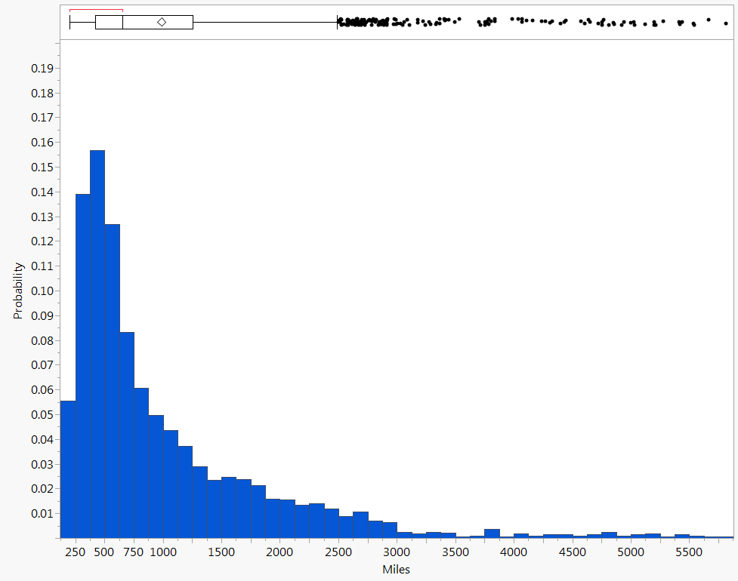
Longest Road Trip Travel Distance

Slide 5
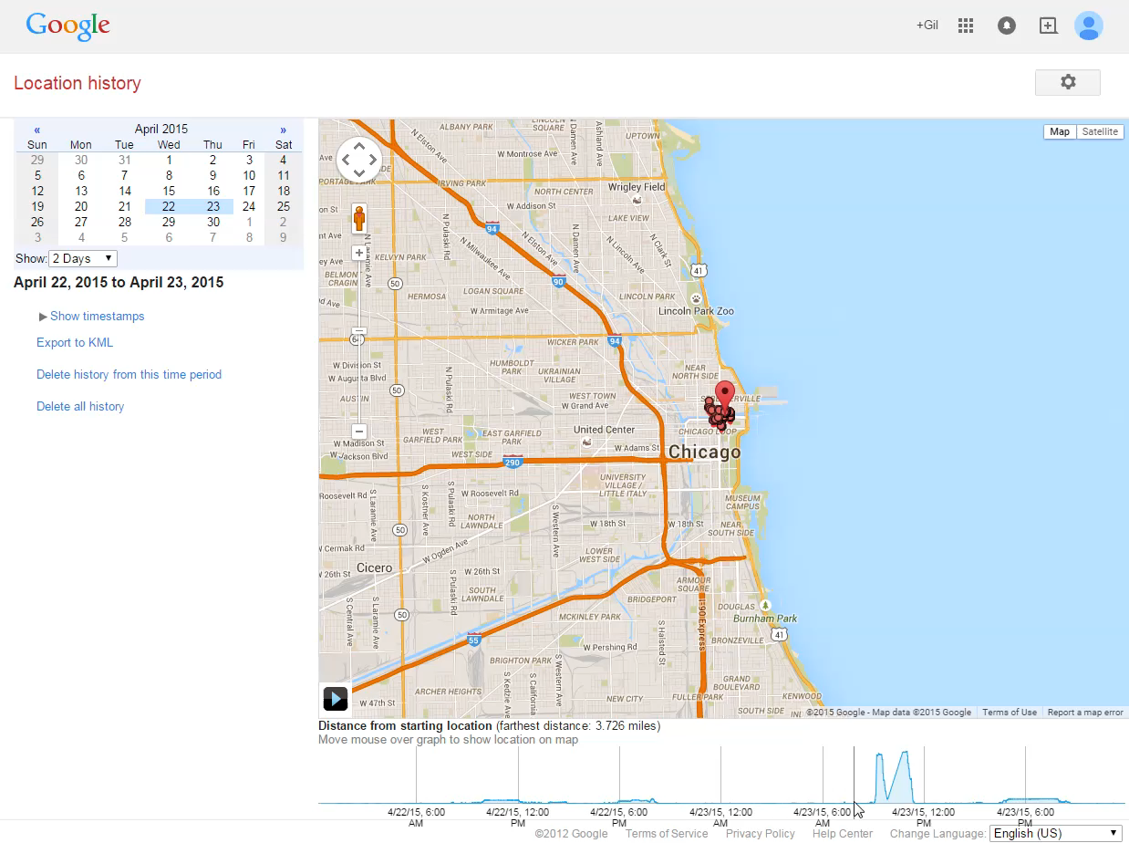
Do you have an Android phone?

Slide 6
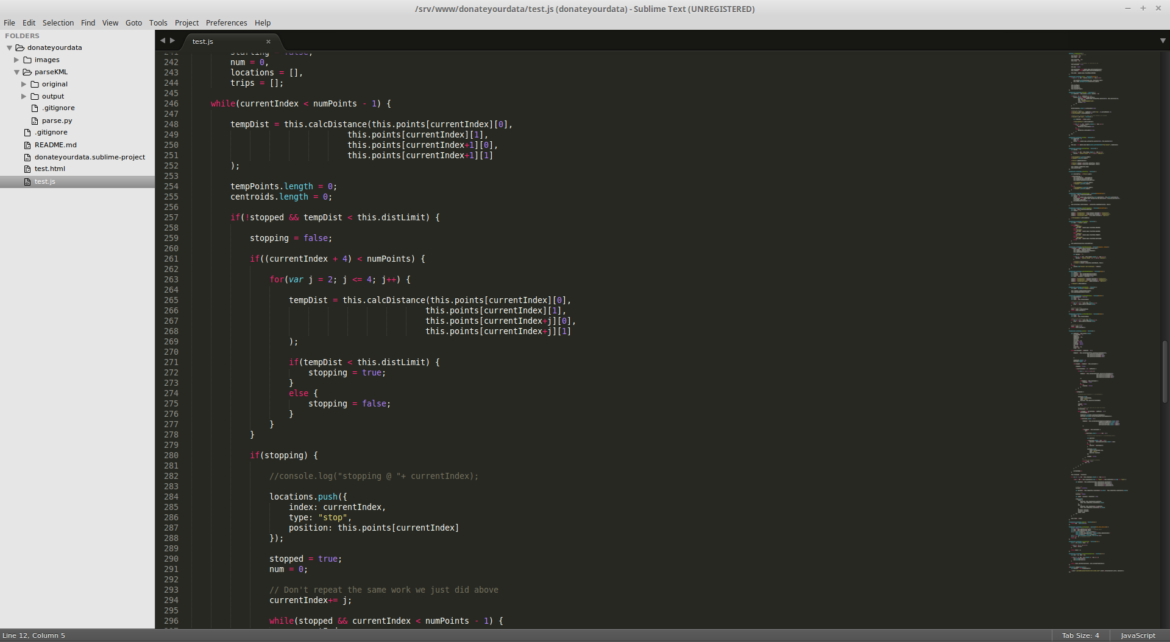
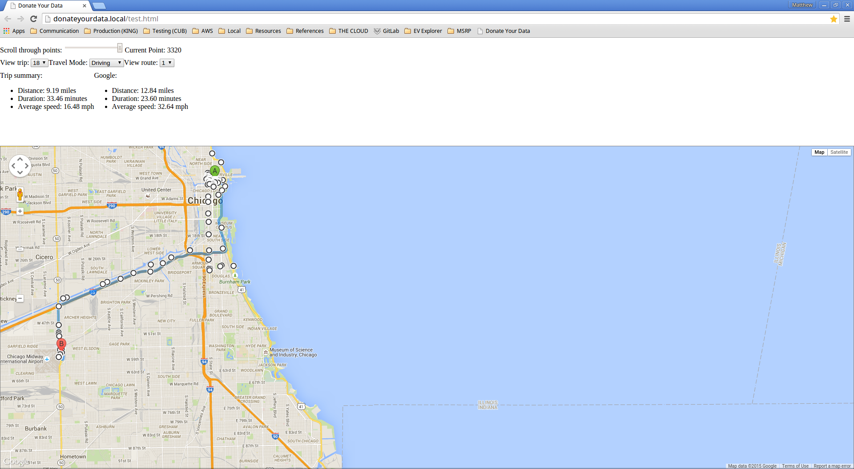
Donate your data

Slide 7
Project Description
(1) Exploring google data to evaluate travel mode, travel distance, average speed and other variables based on researchers’ personal data.
(2) Developing tools to anonymize donated data by randomizing origins and destinations.
(3) Developing a website to guide android users on the steps needed to download their data anonymize it and upload it to our website.
(4) Collecting data in Davis and validating the tool accuracy.

Slide 8
Next Step:
Travel Data Collection Integrated Tool Set
Smartphone passive data
Smartphone survey tool
Web map survey
Prompted-recall travel survey
OBD and vehicle data
Integrated backend server

Slide 9
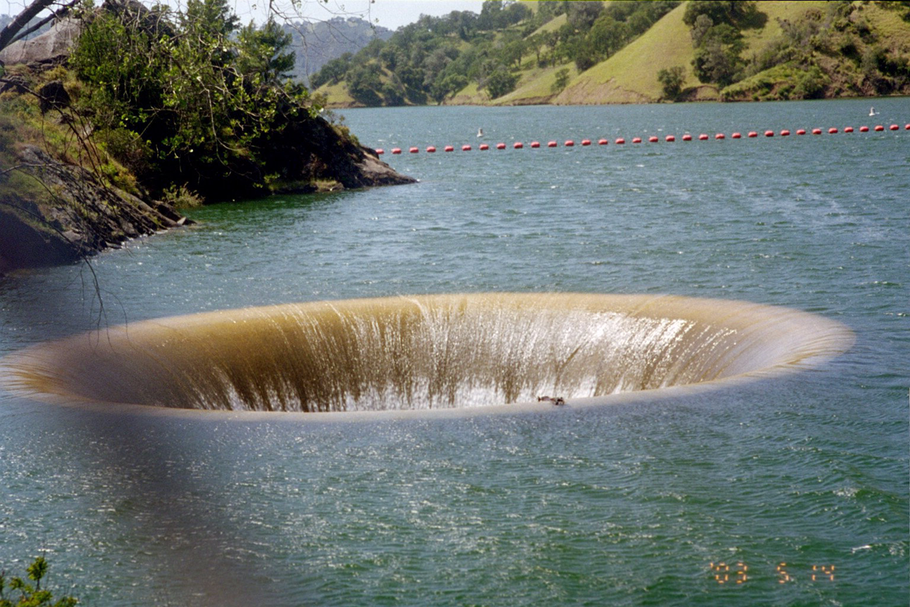
Thank You
Questions?

