Slide 1
MAVRIC: Modeling Analysis, Verification, Regulatory and International Compliance Modeling to Support Policy Analysis

Slide 2
Modeling Analysis, Verification, Regulatory and International Comparisons
What do energy-economic-environmental models and cross-comparison of models tell us about the future of energy system that include transportation?
Key Research Questions:
What do existing models at the California, U.S. and international levels tell us about different possible energy and transportation futures and the paths to those futures?
How have the forecasts and models of market adoption of new vehicle and fuel technologies developed during the STEPS 2007–2010 and NextSTEPS 2011–2014 programs performed relative to their actual market penetration? What lessons can be learned and applied to improve our future models and forecasts?
How do model projections and scenarios compare and what can we learn from each?
How can a wide range of diverse and divergent scenarios/modeling outcomes be used to help inform decision-making and policy design in the face of significant uncertainty? Are there robust strategies that we can identify?
What assumptions are being made and which ones matter most? What metrics of change over time are required to assess the comparative likelihood of alternative energy pathways, including one dominated by shale oil and gas, meeting sustainability goals and timelines?
How can we improve our own scenario making and use our own models in a better fashion to help us assess policies?
Notes:
More detail on these projects in the appendix: ~ slides 44-55.

Slide 3
STEPS 2015 Projects: MAVRIC - Modeling, Analysis, Verification, and Regional and International Comparisons

Slide 4
Models
California
CA-TIMES: Energy System Model for California
Global
GCAM: Global Change Assessment Model
MoMo: Global Transport Energy Model (IEA)
Global Oil Model and Global Gas Model
Transition model
GBSM: Geospatial Biorefinery Siting
Natural Gas Infrastructure model
Hydrogen station siting and rollout models
EV charger siting & rollout models
CCS system model
COCHIN-TIMES (COnsumer CHoice INtegration in TIMES)
Environment and sustainability
LEM: Life cycle emissions models
AVCEM: Advanced Vehicle Cost & Energy Use Model
Water, land, materials & energy modeling
Modeling Comparison
CCPM: CA Climate Policy Modeling dialogue project (December 2013, March 2015)
iTEM: International Transport/Energy Model Comparison Project (December 2014)

Slide 5
Highlights
Climate policies in California and the role of academic modeling efforts in supporting policy analysis
California Climate Policy Modeling Dialogue
California energy system model: CA-TIMES
Adapting Consumer Choice Modeling to analyze non-regulatory policies
Uncertainty Analysis and Robust Decision Making

Slide 6
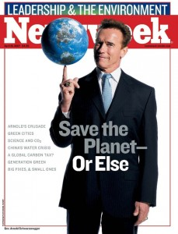
Since 2007, California gov has started a series of legislations/regulations to mitigation GHG emissions

Slide 7
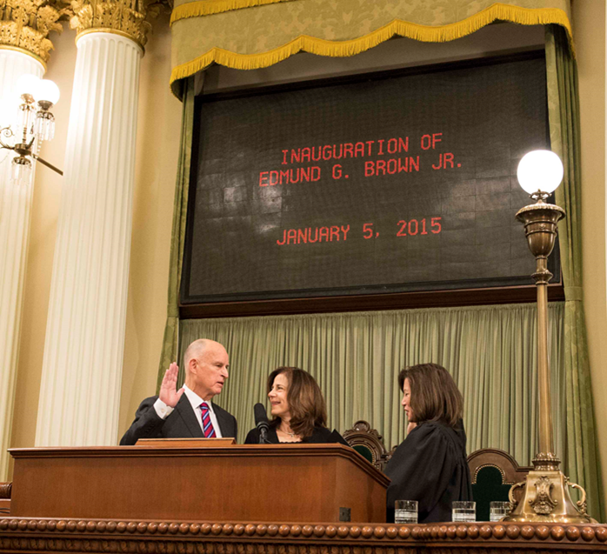
Governor’s 2030 Climate Goals
If we have any chance at all of achieving reductions needed to limit global warming to 2 degrees by 2050 “California must show the way”
2030 goals
Increase to 50% electricity derived from electricity
Reduce petroleum use in cars & trucks by up to 50%
Double energy efficiency achieved at existing buildings & make heat fuels cleaner
Source: CCPM (March 2015)

Slide 8
Business As Usual (BAU) Scenarios CCPM1 (December 2013)
All Models in CCPM2 (2015)
9
Notes:
Original scoping plan – 596 MMT/yr
This is the business as usual trajectory for annual greenhouse gas emissions.
The definition of business as usual differs slightly across models, but for our purposes we’ll say it’s a world without aggressive climate policy and one in which population, income, and consumption continue growing at historical rates.
As you can see there’s a clear relationship between how high the BAU trajectory goes and what year the model is from. This could be the impact of the 2008 recession, or it could be a result of California climate policies really starting to take hold.
For example the two lower BAU cases, LEAP-SWITCH and CA-TIMES both use population and income projections after 2008.
For the rest of the presentation, we’re only really talking about mitigation scenarios… so BAU cases are not in the following slides

Slide 9
Annual vs. Cumulative Emissions? (December 2013)
interim target is important to drive early actions to lower cumulative emissions (and achieve learning & scale)
Annual Emissions = Economy-wide emissions each year (e.g. all emissions in 2010)
Cumulative Emissions = The sum of annual emissions since the year 2010
(e.g. emissions in 2010 + emissions in 2011 +…. emissions in year X)
12/21
11
Notes:
When we start think in terms of cumulative emissions this is what we see.
So here we have the same graph on the left that we just saw… and this is annual emissions. And notice that the y-axis has been rescaled from a max of 1000 to a max of 500 just to help viewing the figure.
On the right, we have these same color coded trajectories translated over to cumulative emissions. So added up year by year from 2010 to 2050.
And here you can see, the dashed brown line on the bottom of the right side figure is GHGIS case 3…. That’s one of the two scenario that actually doesn’t reach 80% by 2050 but it does come in as the lowest cumulative emissions.
The reason to show this is just to highlight that early and aggressive emission reductions can get you to a lower total contribution to climate change by 2050.
Now of course if we extend these trajectories out another few decades to 2070 or 2080 the GHGIS scenario may not be as attractive as one with extrememly low annual emissions.

Slide 10
Observations from first CCPM forum (December 2013)
Future modeling efforts should focus on the:
economic impacts and logistical feasibility of given scenarios,
interactive effects between two or more climate policies,
role of uncertainty in the state’s long-term energy planning, and
identification of pathways that achieve the dual goals of criteria pollutant and GHG emission reduction.
Modelers need to work with policy makers more closely to represent the details of the policy design
Data availability and data/model transparency is absolutely essential.
Identifying ways to make the models and model findings more useful and accessible to policy-makers and stakeholders.
5

Slide 11
Key Observations: CCPM2 (March 2015)
More models show cost impacts: $/HH, $/kWh
More discussion about jobs and heterogeneity of impacts
Forks in the road: Studies illustrate major paradigm shifts necessary for 2050 goals
Massive expansion of biogas production/use
OR large scale electrification of vehicles as well as industrial and home heat usages
Each fork will eventually requires irreversible investments by someone.
Are these really forks at the state policy level?
Individuals must choose, but don’t all have to make same choice
Can’t there be a mix of electric heating and biogas?
INDUSTRIES WANT MAXIMUM FLEXIBILITY!

Slide 12

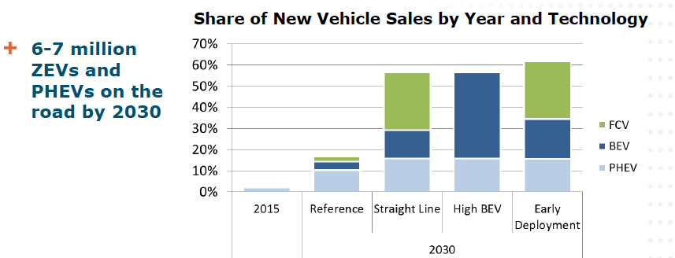





The Big Gap between Scenario Analysis and Consumer Preferences
PATHWAYS: If we do everything technically feasible…
CA-TIMES: If we need to meet the policy objective, the least cost pathway is….
2.4 million vehicles (~1.1M BEV/PHEV, 1.3MFCV) in 2030
CGEs: If we achieve climate policy goals, what would be the direct and indirect economic impacts…

Slide 13
Overview of Model Approach
Energy Systems Models
Technology rich on the supply side, but lack behavioral details
Consumer Choice Models
Detail choices on the demand side but lack supply sector details
Our focus: ‘Marrying’ these two types of models
Minimal Supply rep.
Consumer Choice Model
Demand-rich
+
Supply rich
TIMES model
Minimal behavior rep.
=
Supply-rich
COCHIN-TIMES
Demand-rich
COCHIN: COnsumer CHoice INtegration

Slide 14
Motivation for Consumer Choice
System-engineering models typically assume society is homogenous, i.e. there is only one decision-maker at the societal level
Consumer behavior cannot be ignored in system-wide modeling!
One objective of this project is to develop a bridging approach to bring in consumer behavioral parameters, to the linear programming framework of TIMES

Slide 15
Need for Consumer Choice in Policy Analysis
Consumer Choice
Monetary Costs
Disutility Costs
Vehicle Price
Fuel Cost
Perception
Infrastructure support
Vehicle Purchase
Consumers make decisions based on monetary costs, such as vehicle price, fuel cost, as well as the ‘disutility’ costs, such as their perception of a technology on various issues, and the infrastructure support available.

Slide 16


Components of Disutility Cost in the year 2020
Model Availability Cost
Risk Premium
Urban
Refueling Inconvenience Cost
Charger Refueler Cost
Towing Cost
Early Adopter
Range Anxiety Cost
Moderate driver
Model Availability Cost
Risk Premium
Refueling Inconvenience Cost
Rural
Charger Refueler Cost
Towing Cost
Range Anxiety Cost
Late Majority
Frequent driver

Slide 17
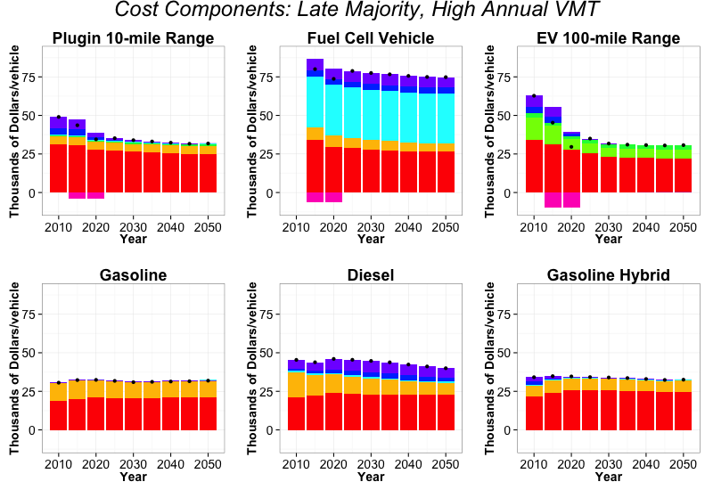
Vehicle Cost
Fuel Cost
Range Anxiety Cost
Refueling Cost
Risk Premium
Subsidy
Electricity Cost
Model Availability Cost
Total Cost

Slide 18

PG&E and ITS-Davis Collaboration on CA-TIMES

Slide 19







CA-TIMES Model Improvements (2015)
Reviewing and updating model input assumptions
Enhancing and improving model output capabilities
Heterogeneity and consumer choice in transportation
Parameter uncertainty (Monte Carlo simulations)
Mitigation Options
Cost Effectiveness
Technology forcing policies (learning-by-doing)
Interactive Effects of Policies
Electricity demand response for load shaping and peak reduction
Demand Response
Water demand/supply technology
Uncertainty Analysis
Energy supply and delivery (storage)

Slide 20

Model infrastructure for Addressing Uncertainty
Richard Plevin, Ph.D.
Institute of Transportation Studies
University of California – Davis
plevin@ucdavis.edu
STEPS Spring Symposium
May 13, 2015

Slide 21


WHY UNCERTAINTY ANALYSIS?
“Failure to engage in systematic sensitivity and uncertainty analysis leaves both analysts and users unable to judge the adequacy of the analysis, and the conclusions reached.”
Morgan & Henrion (1990)
“Deterministic point estimates sometimes enjoy a precise and/or accurate appearance, and inspire a misleading sense of confidence.”
(Cullen & Frey p. 7)

Slide 22
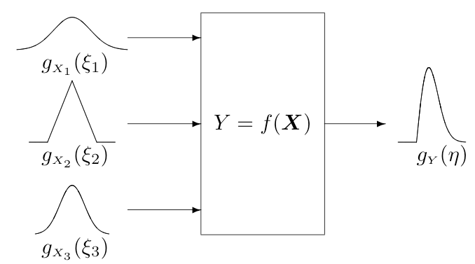
BACKGROUND: MONTE CARLO SIMULATION
Describe input parameters using probability distributions
Run model numerous times and save results
For each run, values are selected from each input distribution
Accumulated outputs describe a frequency distribution
Figure: JGCM 101:2008

Slide 23
WHY NOT UNCERTAINTY ANALYSIS?
Barriers to addressing uncertainty
Limited technical know-how
Increased complexity
Long run-times preclude Monte Carlo analysis
Unknown parameter distributions
Scenario uncertainty dominates parametric uncertainty

Slide 24
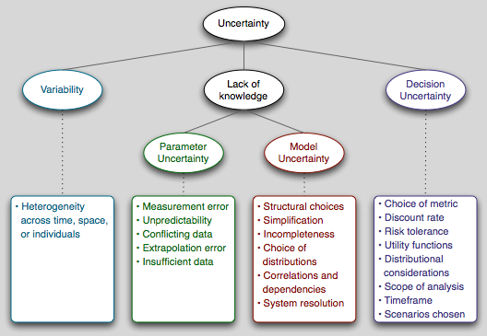
APPROACHES TO ADDRESSING UNCERTAINTY
Monte Carlo Simulation
Non-stochastic methods
Notes:
There are several type of uncertainty -- variability and parametric uncertainty, as well as model uncertainty and uncertainty about decisions about which there isn’t an objectively correct answer. Most analyses consider only variability and parametric uncertainty.

Slide 25
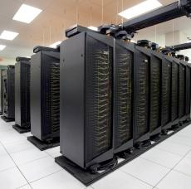
MONTE CARLO SIMULATION ➡ ROBUST DECISION-MAKING
Features in common with MCS
Generate input parameters
Run on computing cluster
Collect results into database
Analyze results
Additional requirements
Non-probabilistic methods
PRIM or similar analysis
Visualization features
High-speed parallel computing system at NERSC.gov

Slide 26

ROBUST DECISION-MAKING
Addresses “deep” uncertainties
Disagreement about model form, probabilities, value-based judgments
Focus is robustness rather than optimization or prediction
Model is used to explore the parameter space
Notes:
Deep uncertainty is when decision makers cannot agree upon the system model that relates action to consequences, the prior probabilities on the inputs to the system model(s), or the value function that ranks the desirability of the consequences.

Slide 27
ROBUST DECISION-MAKING: “XLRM” Framework
Uncertain Factors (X)
Well-defined distributions
Deep uncertainties
Policy Levers (L)
Actions that modify the system
Potential strategies to explore
Alternative Futures
Strategies
Model relationships (R)
Links among Xs, Ls, and Ms
Model equations
Iterate
Outcomes
Performance metrics (M)
Gauge policy performance
Single or multiple-attribute
Notes:
Policy levers (“L”) are near-term actions that, in various combinations, comprise the alternative strategies decisionmakers want to explore.
• Exogenous uncertainties (“X”) are factors outside the control of decisionmakers that may nonetheless prove important in determining the success of their strategies.
• Measures (“M”) are the performance standards that decisionmakers and other interested communities would use to rank the desirability of various scenarios.
• Relationships (“R”) are potential ways in which the future, and in particular those attributes addressed by the measures, evolve over time based on the decisionmakers’ choices of levers and the
manifestation of the uncertainties. A particular choice of Rs and Xs represents a future state of the world.

Slide 28
REDUCING GHG EMISSIONS FROM TRANSPORTATION
Strategies that might be compared in RDM:
Treatment of biofuels
Indirect effects
Risk penalty for fuel with uncertain GHG effects
Feedstock restrictions (waste and residues only)
Sectoral or economy-wide (e.g., C tax, cap & trade)
Foresight about ramping cost or targets
Address path dependence
Encourage faster behavioral change
Emphasize RD&D of zero-carbon solutions

Slide 29
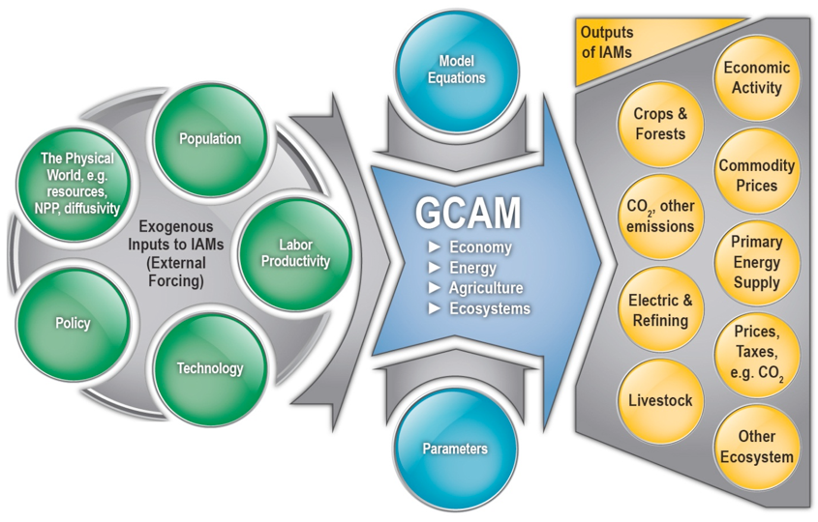
GLOBAL CHANGE ANALYSIS MODEL (GCAM)
Long Term Shifts in Life Cycle Energy Efficiency and Carbon Intensity Mitigating
Climate Change: Decomposing the Relative Roles of Energy Conservation, Technological Change and Structural Shift
Transportation forecasts in various scenarios from IPCC’s SSPs and RCPs (Representative Concentration Pathways or Target Climate Goals)
International Transportation Modeling Comparison (ITEM)
http://prima.pnnl.gov/sites/default/files/Integrated.jpg
Notes:
Integrated view of global energy use, environment, and economy, e.g., policy costs and GHG -> temperature changes.
The Global Change Assessment Model (GCAM) is a partial equilibrium model of the world with 14 regions. GCAM operates in 5 year time steps from 1990 to 2095 and is designed to examine long-term changes in the coupled energy, agriculture/land-use, and climate system. GCAM includes a 151-region agriculture land-use module and a reduced form carbon cycle and climate module in addition to its incorporation of demographics, resources, energy production and consumption.

