Slide 1
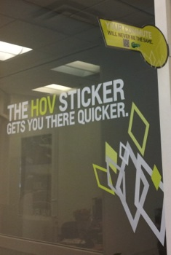
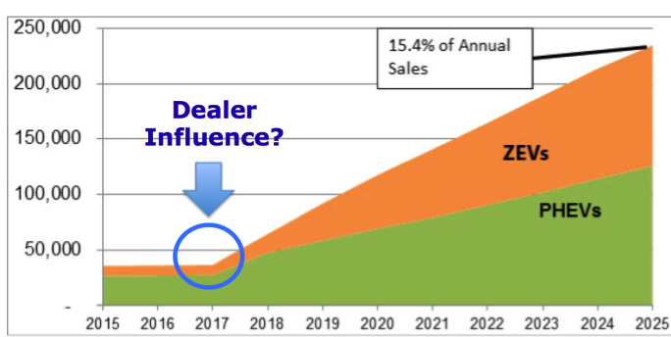
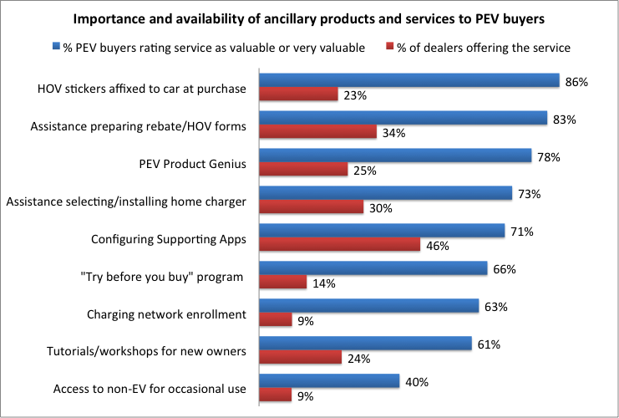
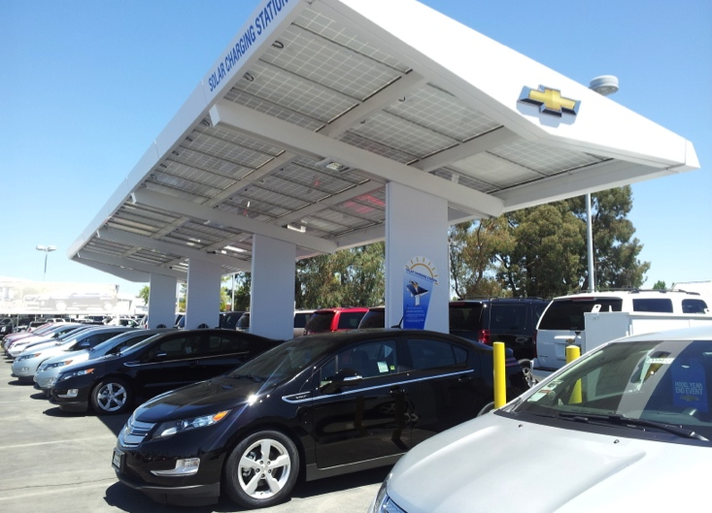
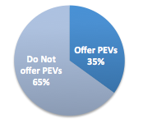
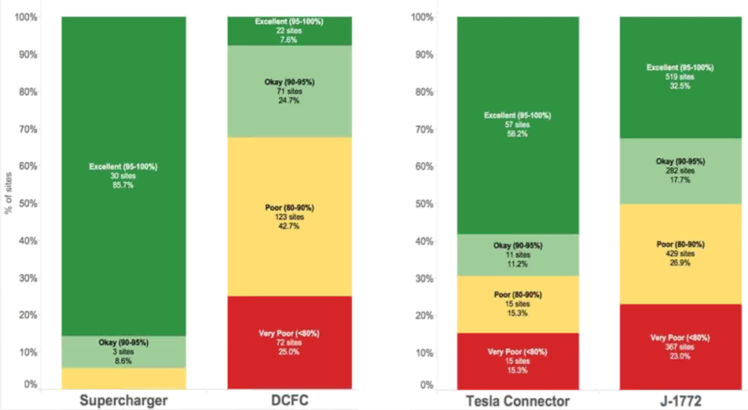
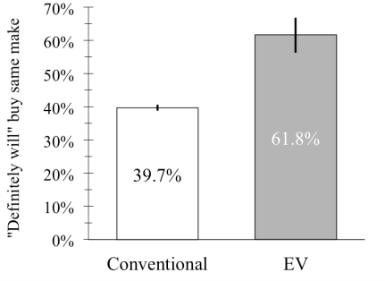
EV Distribution Strategy, Retail Performance and Policy
Eric Cahill, Jamie Davies, and Tom Turrentine
Institute of Transportation Studies, University of California, Davis - December 2015
How does retail structure impact PEV sales?
PEVs and Market Access
Contributors to lower performance
PEVs hold distinctly different value for customers, entail material changes in consumer behavior and require new fueling and support infrastructure on which customers rely. New car dealers may be ill-equipped to sell these radically innovative new products, with potentially adverse consequences for PEV adoption. Marketing theory suggests that success in bringing radically different technologies to market depends on whether manufacturers can match an appropriate distribution strategy to the type of innovation being introduced. I examine the relationship between innovation form and distribution strategy by analyzing national new car buyer survey data from automotive research firm J.D. Power and by conducting a total of 43 interviews with automakers and new car dealers in California’s core PEV markets.
The analysis revealed PEV buyers rated new car dealers much lower than buyers of conventional cars and reported much lower intended loyalty to those manufacturers as a result. Buyers of PEVs from Tesla, which uses a direct-to-customer sales model reported much higher retail satisfaction and higher intended buyer loyalty. I suggest a dual-path approach for policy aimed at mitigating distribution-related barriers by: (1) Aligning government-funded incentive programs with industry practices through more “retail friendly” policies that reduce uncertainty for dealers and end customers, and (2) Empowering manufacturers to pursue alternative market pathways for distributing PEVs.
Different forms of innovation call for different product introduction strategies (e.g., Olson, Slater, and Hult 2005, Slater and Mohr 2006, Vorhies and Morgan 2003). New product performance is tied to how well firms organize structurally and behaviorally to recognize and respond to different innovations with a strategy well matched for that innovation type (Olson, Slater, and Hult 2005). Organizational skill sets that were appropriate for commercializing some technologies may not be well suited to other types (Slater and Mohr 2006).
Mismatch between effort required and initial demand (proportion of PEVs to conventional vehicles sold) and relative profitability
Lack of differentiated customer satisfaction metrics for PEVs
Traditional training lacks “hands on” learning important for PEVs
Endemic high sales staff turnover hinders knowledge retention
Price-based competition amongst dealers undermines investment in retail innovations and customer support specific to PEVs
New product success hinges on a proper match between technology type and distribution strategy
Type of Innovation
Incremental
Disruptive (EVs)
Distribution Strategy
Traditional
Niche-based
Implications for Policy
Poor customer satisfaction scores may negatively impact PEV sales and deter more dealers from choosing to sell PEVs, which negatively affects availability
Negative word-of-mouth from early customers unable to realize the full value of PEV ownership due to lost opportunities to provide retail-level customer support:
Lack of confidence in availability, usability, and reliability of charging infrastructure
Unable to tap full value of rebates, tax benefits, discounted electricity rates, HOV lane access
Insufficient savings in gas, service and maintenance, insurance
Systemic under-investment in support for PEV customers could translate into fewer buyers
Why might dealerships matter?
ZEV Program → 15.4% of sales by 2025
Governor’s goal of 1.5 million ZEVs by 2025
2013 California ZEV Action Plan:
“Encourage and support auto dealers to increase sales and leases of ZEVs.”
How should policy support dealers?
Concern regarding impact of poor purchase experience on PEV sales and market growth
New Product Performance
Survey data
(JD Power 2013 Sales Satisfaction Index Study)
Interviews
Adapted from Slater & Mohr (2006)
“Retail-friendly” policies needed
Data shows a rocky start for PEVs sold through dealers
Offer performance-based dealer incentive on the order of $500 to $1,000 per unit.
Give dealers the confidence to market public incentives by:
Allowing dealers to reserve state rebate funds upon taking PEV inventory from carmakers;
Increasing PEV access to HOV lanes;
Waiving state sales taxes on PEVs; levy reasonable road use fees.
Put more “butts in seats” and drive more traffic to dealers by reducing minimum ownership period requirements to 24 months for state rebate eligibility.
Exempt carmakers from franchise restrictions up to X number of EVs sold annually.
Bridge the knowledge gap by establishing a “retail friendly” central data repository for public and utility incentives; make available to 3rd-party software and app developers.
Lift sanctions preventing an expanded role for electric utilities to include marketing of PEVs as a category and deployment and operation of charging infrastructure.
Gain top-down buy-in from dealers in stages according to psychographic profile: e.g. win over pragmatist dealers by capturing and sharing best practices and success stories via targeted outreach and venues for knowledge exchange.
Launch or continue dealer recognition programs.
Provide a downloadable standard window label for displaying public incentives and PEV pricing in terms of initial out-of-pocket cost and monthly total cost of ownership (include a QR code for quote tailored to individual customers).
Source: ARB Staff Report (2012)
Do PEV buyers expect more from dealers?
When firms introduce substantially new high-tech products there is often a gap between the promised value proposition and the ability of the product to fulfill that promise. Initial survey results suggest PEV buyers need assistance navigating the new features, infrastructure, and services that help them realize the benefits of PEV ownership. Most dealers have not yet developed or implemented many of these value-added services.
Franchise laws in all 50 states restrict the path to market through independent franchised dealers
Policies and incentive programs do not currently account for dealers or for how dependency and power relations might influence or constrain needed OEM-dealer coordination
Objectives of the study
The aim of the study is to inform policies for increasing PEV sales and market growth. The study sets out first to determine whether customers are satisfied with the experience of buying or leasing a PEV. It considers the adverse implications of deficient retail support on PEV market development. It then explores some of the factors that could impact the quality of the purchase experience and the drivers affecting dealer engagement in PEV sales. The research accomplished the following:
Examined retail-level considerations affecting PEV sales and inform decision leaders.
Provided the foundation on which to model and test hypotheses for affecting PEV sales through the retail-level dynamics and processes identified.
Hosted a PEV dealer workshop to share and consider preliminary data and insights.
Showcased pioneering dealers and promulgated best practices for sale of zero emission vehicles.
Submitted a comprehensive report with policy guidance to CEC.
PEV buyers rated dealers significantly lower in sales satisfaction than conventional car buyers. This holds across all major performance indices (facility, salesperson, “the deal” and delivery). Tesla earned industry-high marks using a pure direct sales model.
Research Questions:
Is the purchase experience better or worse for PEV buyers? What are the implications?
What drivers and barriers affect dealer participation and performance?
What are the opportunities for policy?
PEVs entail greater burdens for dealers
Many dealers cite longer transaction times and a lengthier delivery process for PEVs. PEV buyers, however, report almost no difference in these times. Dealers also cite a longer “sales process” for PEV buyers. Transaction data shows that dealer gross profits on PEVs, while comparable to conventional vehicles, may not be compelling enough to convince more dealers to take on these added burdens based on profit alone.
Milestones, Publications and Partners
Source: ARB 2013-2014 California CVRP survey data
Approximately 35% of California new car dealers choose to sell PEVs.
Convened PEV Retail Workshop hosted by ITS-Davis (June 2014)
Submitted final report to California Energy Commission (December 2014)
Cahill, E.C., Davies-Shawhyde, J., Turrentine, T., & Sperling, D. (2015). New Car Dealers and Retail Innovation in California’s Plug-in Electric Vehicle Market. Transportation Research Board 94th Annual Meeting Compendium of Papers.
ITS-Davis Policy Brief and GreenLight Blog series posts, November 2014
Cahill, E., (2014, December 8). [Letter to the Editor]. Automotive News, p. 12.
A Car Dealer’s Won’t Sell: It’s Electric, New York Times, November 24, 2015.
Dissertation [accepted and in-press, release in January 2016]
Data Collection:
Analyzed buyer survey and dealer transactional data from J.D. Power; also CVRP data from CSE
Recorded 80+ hours of interviews from California new car dealers, automakers, utilities, others
Co-developed questions on buyer experience inserted into Clean Vehicle Rebate Program Survey
Dealer “PEV Champions” institute different approaches:
Tap seasoned, tech-savvy sales reps as PEV specialists
Scale sales expertise with demand
Build competence via regular use of PEVs by sales staff
Frame price in terms of initial and monthly total cost
Targeted marketing and grass roots outreach
Engage utilities and other stakeholders
Key deficits in dealer performance
PEV product knowledge/expertise
PEV public and utility incentive knowledge/expertise
Inventory (available selection and display of PEV models and trim levels)
Lack of support for PEV-specific needs
Source: ARB 2013-2014 CVRP survey data
Retail experience impacts loyalty to carmakers
(Could it affect loyalty to PEVs???)
Dealers play a central role
Tesla charging sites far ahead in driver satisfaction ratings
We gratefully acknowledge…
2013 Total new car sales in California: 1.71M
1,292 new car dealers in California
12% of state sales taxes
6.3% of state retail sector jobs
Dealers earn profits from:
Sale of new and used cars, and accessories
Financing of vehicle purchases/leases
Warranty, service, maintenance, and parts
Dealers add value for automakers & consumers:
Intimate knowledge of local markets
Facilitate complex financial transactions
Provide warranty, service, repair, and parts
Path to market is set by state franchise laws, which limit automaker influence over the sales channel.
Implications for ZEV sales include:
Automakers cannot dictate that dealers sell PEVs; dealers must voluntarily choose to do so
Automakers are unable to deploy uniform sales practices for PEVs, resulting in higher variability in sales quality
Automakers have a limited period (typically 6 months) to develop PEV-specific performance standards before all dealers gain the right to sell them, contributing to variability in sales quality
Dealer uptake of PEVs may follow consumer technology adoption patterns, further delaying PEV availability
Mass Market
Select references
Coombs, R., Harvey, M., and Tether, B. 2003. “Analysing distributed processes of provision and innovation.” Industrial and Corporate Change, 12(6), 1125-1155.
Klein Woolthuis, R., Lankhuizen, M., & Gilsing, V. (2005). “A system failure framework for innovation policy design.” Technovation, 25(6), 609-619.
Markard, J., & Truffer, B. (2008). “Actor-oriented analysis of innovation systems: exploring micro–meso level linkages in the case of stationary fuel cells.” Technology Analysis & Strategic Forecasting, 20(4), 443-464.
Marx, T. G. (1985). “The development of the franchise distribution system in the US automobile industry.” The Business History Review, 465-474.
Slater, Stanley F., and Jakki J. Mohr. 2006. "Successful Development and Commercialization of Technological Innovation: Insights Based on Strategy Type." Journal of Product Innovation Management 23 (1):26-33.
Taylor, Margaret. 2008. "Beyond technology-push and demand-pull: Lessons from California's solar policy." Energy Economics 30 (6):2829-2854.
Premium Market
Source: Plugshare, 12/01/2015. CA sites categorized by % positive + neutral reviews over previous 12 months. DCFC includes public and restricted sites in CA.
Source: 2013 JD Power Sales Satisfaction Index Study
For questions, please contact:
Eric C. Cahill (eccahill@ucdavis.edu)

