Slide 1
Travel Behavior, Now & Next
Presentation to UC Davis Sustainable Transportation Energy Pathways
David Ory | dory@mtc.ca.gov
November 30, 2016

Slide 2
5

Slide 3
1

Slide 4


Slide 5
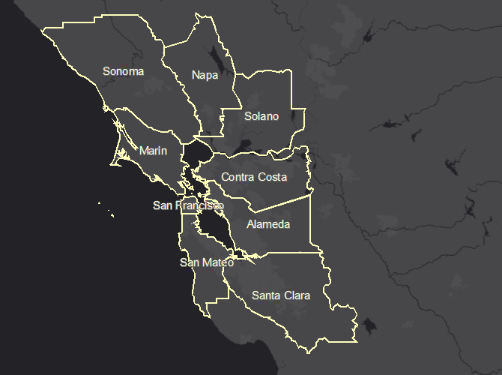

Slide 6
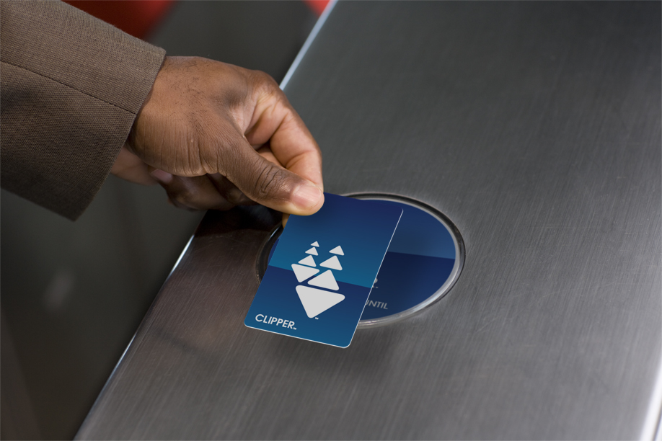
Photo: flickr.com/Sam Churchill

Slide 7
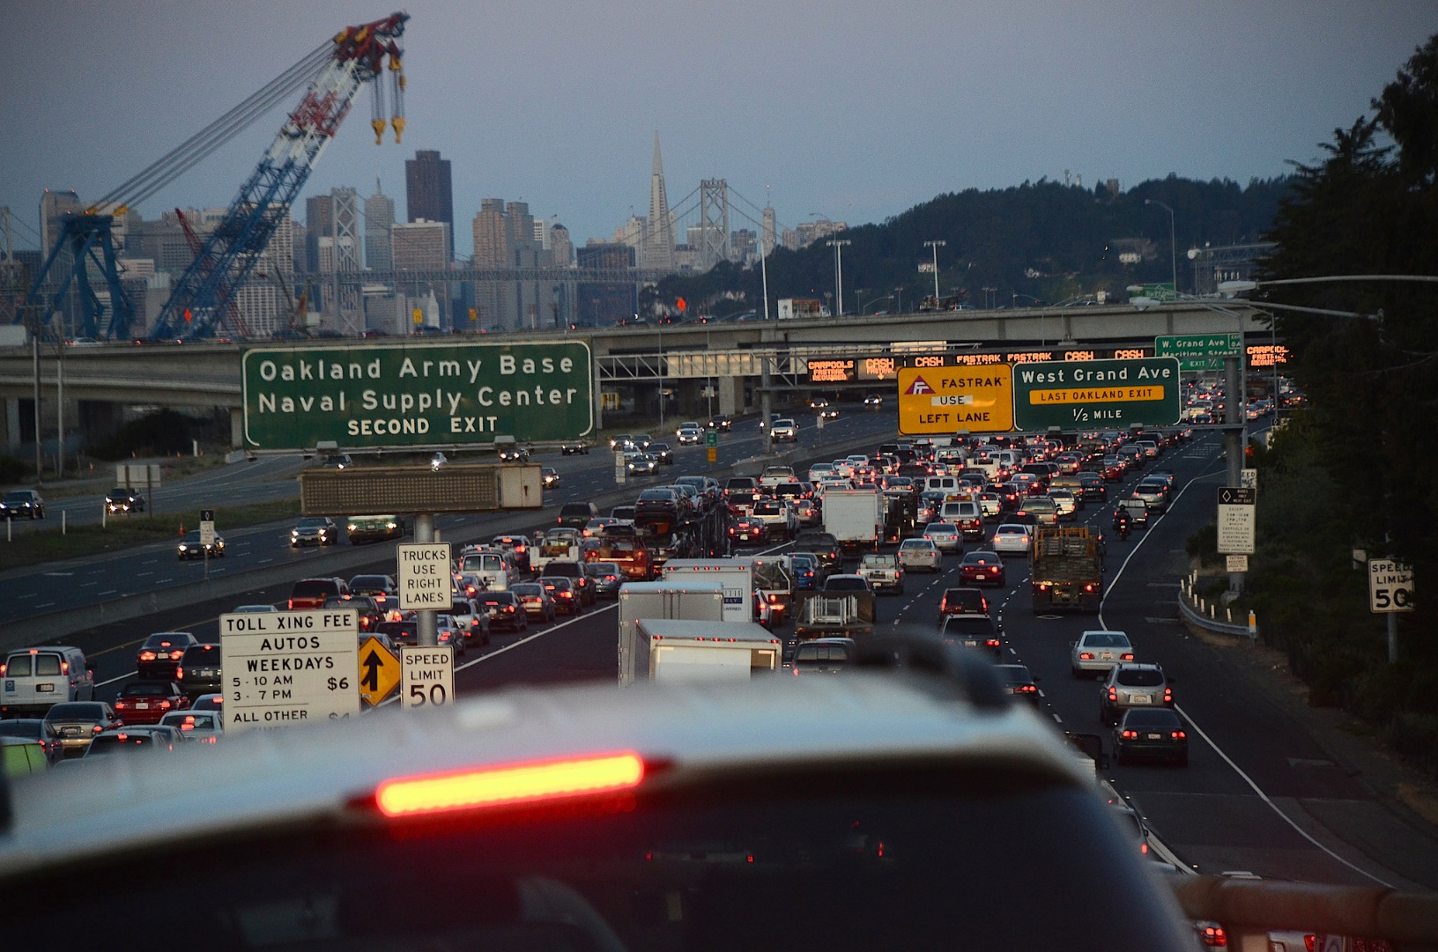
Photo: flickr.com/Russell Mondy

Slide 8
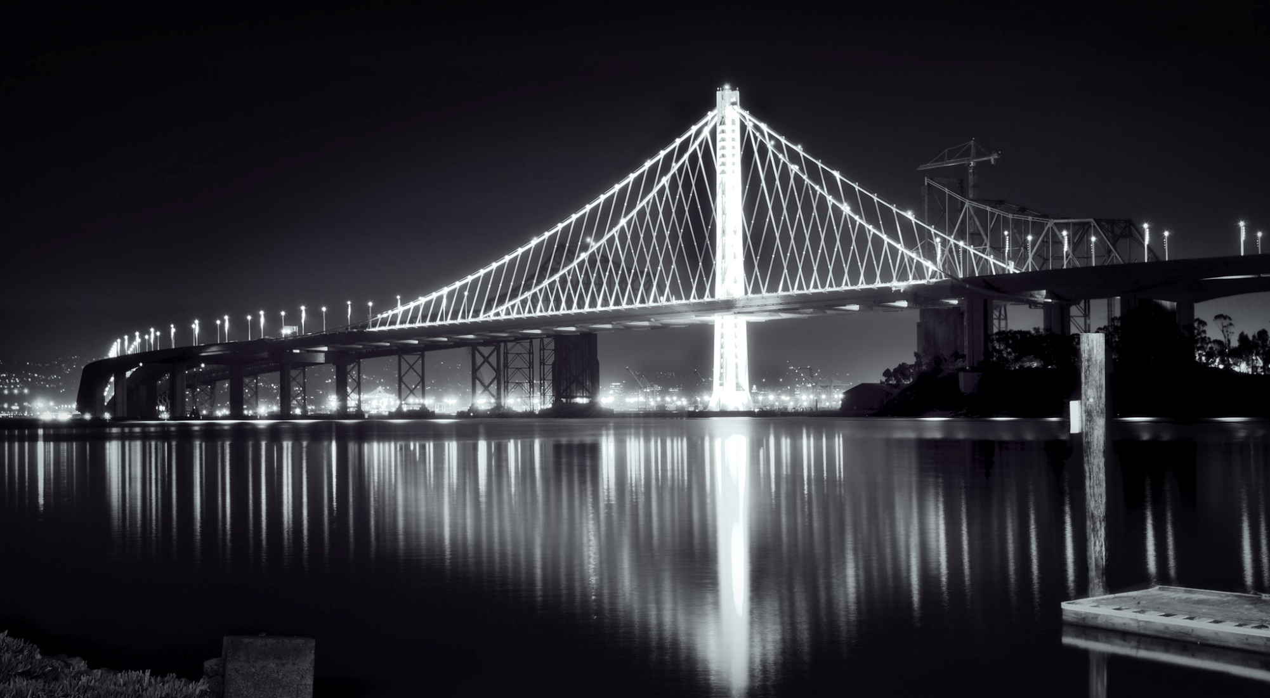
Photo: flickr.com/Bastian Hoppe

Slide 9


Slide 10


Slide 11
2

Slide 12
Micro-economics of Travel Mode Choice

Slide 13


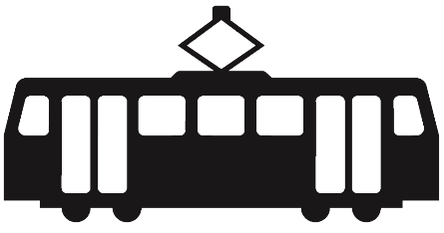

Slide 14
My San Francisco Commute Today

Slide 16
Nearly Every Trip in Phoenix Today

Slide 18
My Future San Francisco Commute

Slide 19
Most Analyses Stop Here

Slide 20
Nearly Every Trip in Phoenix in the Future

Slide 22
3

Slide 23
Provocation

Slide 24
Ride-sharing has peaked.

Slide 25
Technology will do little else to address short-comings (namely: sitting next to a stranger in a confined space).

Slide 26
Uber, Lyft, et al., are unlikely to be less regulated tomorrow than they are today.

Slide 27
Interest in high-occupancy vehicle infrastructure is waning
~1500 lane miles in 1995
~3000 lane miles in 2005
~3300 lane miles in 2010
Conversions to HOT

Slide 28
Government unlikely to intervene

Slide 29
4

Slide 30


Slide 31
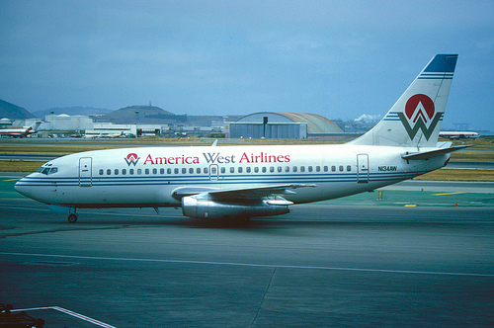
Photo: flickr.com/Aero Icarus

Slide 32
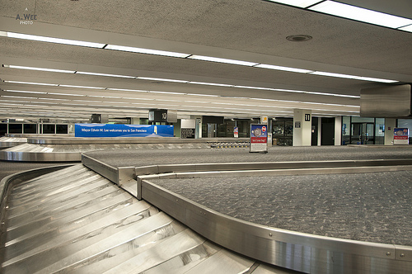

Slide 33
“Hey, hey buddy, you need a ride downtown?”

Slide 34
Legal?
Might be cheaper?
Safe?
Sure would be convenient?

Slide 35
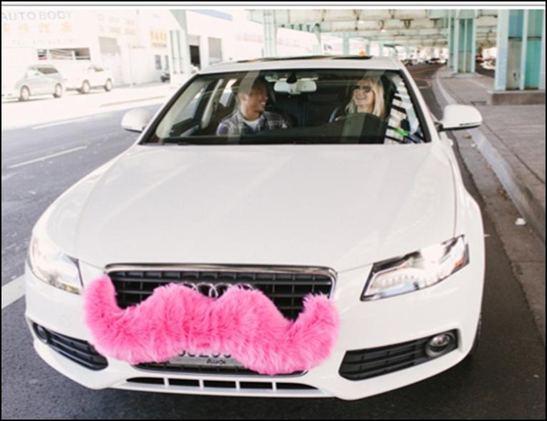

Slide 36
Provocation

Slide 37
Government will have no easier challenge in the future transport realm than Lyft.

Slide 38
Old problem
Quintessential regulatory need
Government failed twice
→ Politics in transport is hard

Slide 39
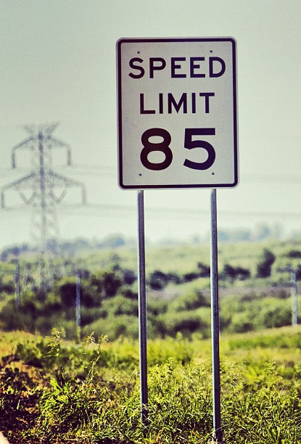
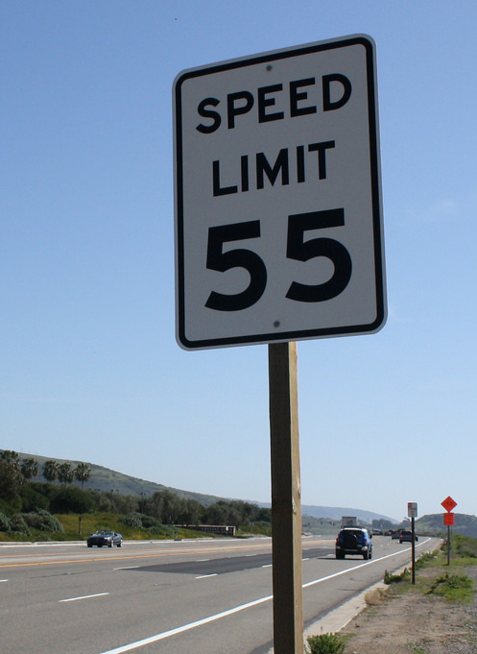
Photos: flickr.com/David Lofink, /Art Jonak

Slide 40
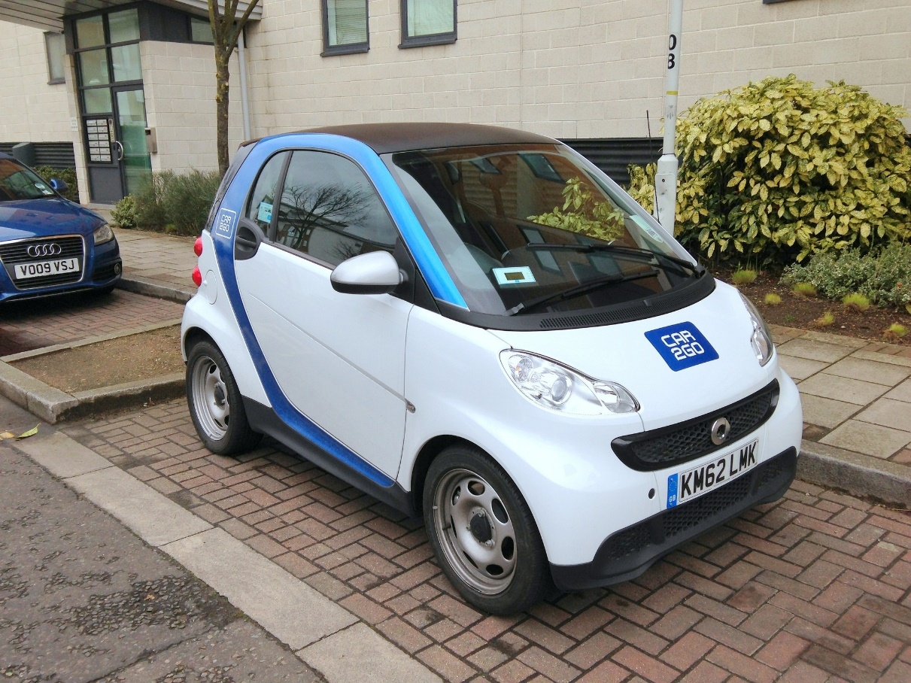
Photos: flickr.com/Mark Oliver

Slide 41
5

Slide 42
Automated
Shared
Electric

Slide 43
Automated
Shared High-amenity City Urban Policy-making
Electric

Slide 44
Dense, Urban Places Make Transport Alternatives Possible … but it’s hard.

Slide 45
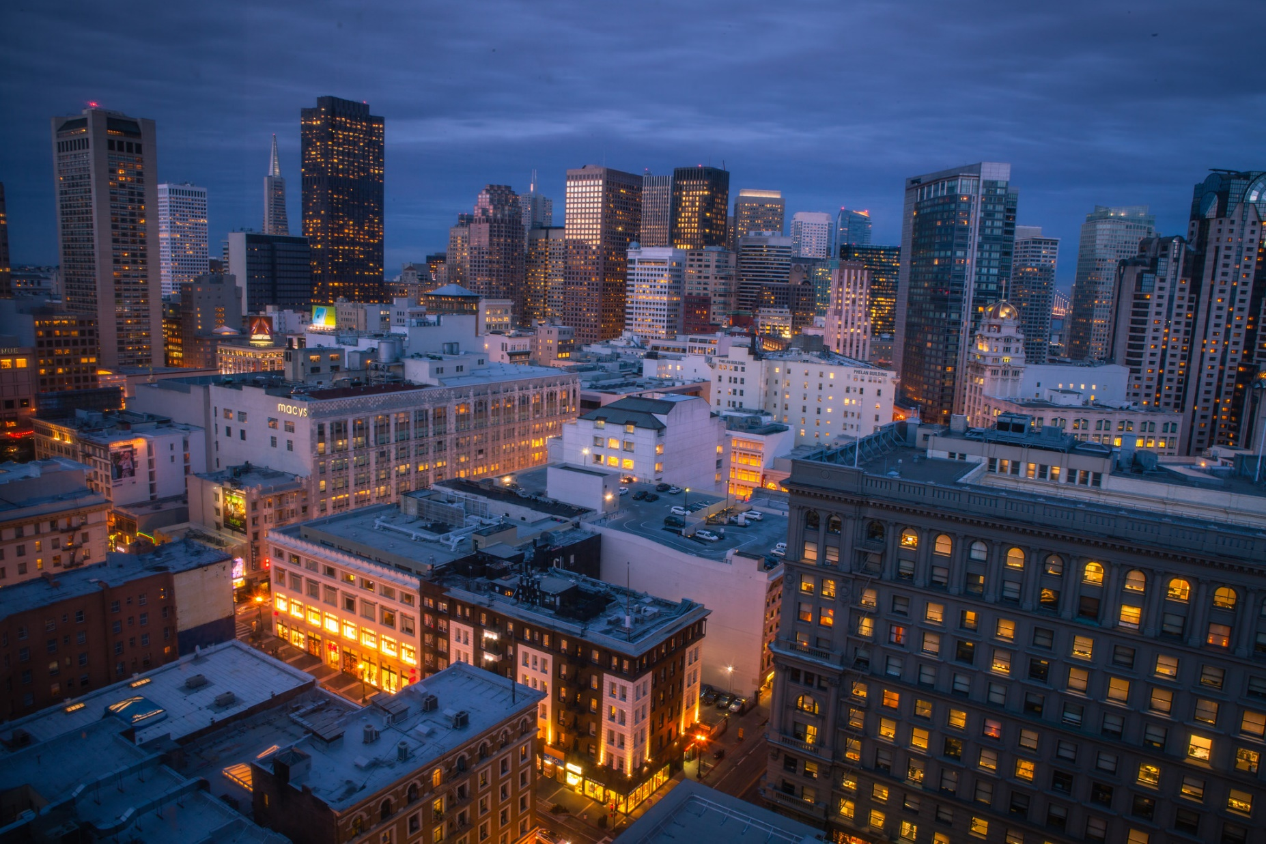
Photo: flickr.com/Anh Dinh

Slide 46
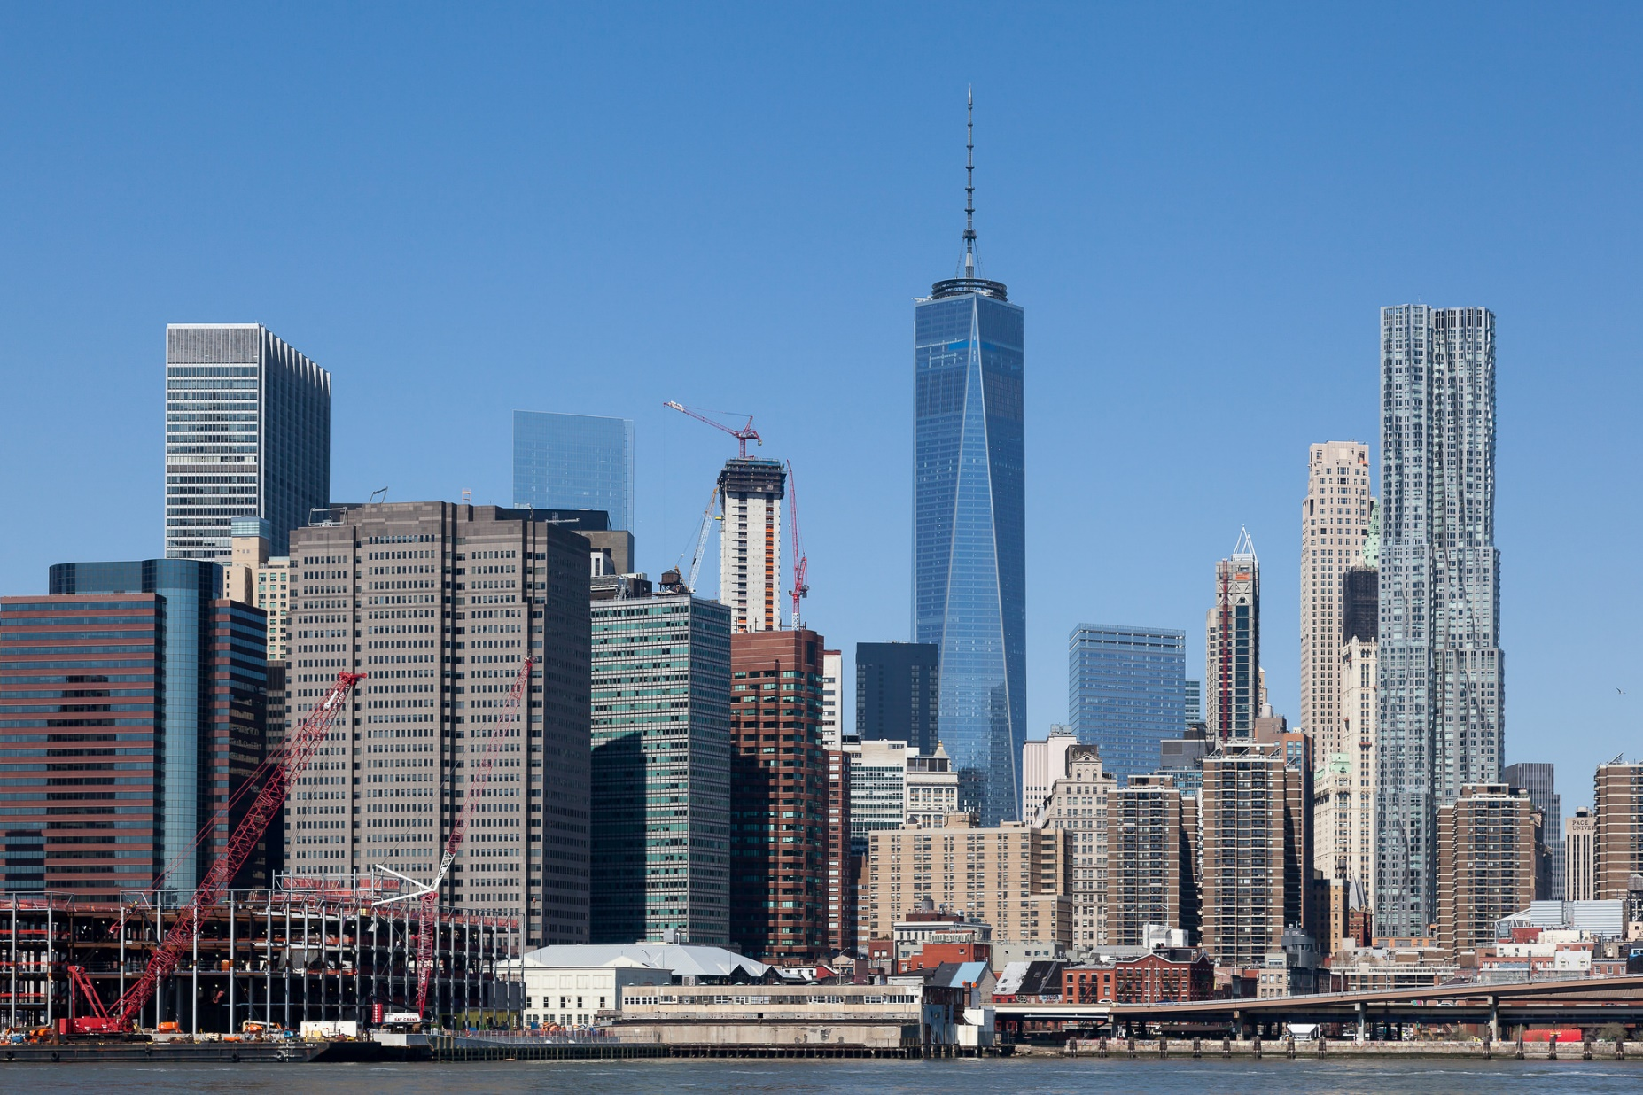
Photo: flickr.com/Guido Barberis

Slide 47
</fin>

