Slide 1
iTEM-2 Conference Modeling results: what does it tell us about 2 degree scenarios?
Joshua Miller
STEPS Symposium
Nov 30 2016

Slide 2
ITEM collaboration involves models with transport, energy-economics, and climate-energy structures
 | Transport focused | Energy-economics focused | Climate-energy focused
CGE-hybrid |  | MIT–EPPA
Optimization |  |  | Chalmers–GET IIASA–MESSAGE
Simulation |  | EIA–WEPS+ | PNNL–GCAM
Accounting/Stock-turnover model | Statoil ICCT–Roadmap BP Shell ExxonMobil ITF-LDV IEA–MoMo

Slide 3
Opportunity for data sharing and collaboration
iTEM2
Notes:
As well as sharing modeling methods, findings, policy implications

Slide 4
Growth in demand for passenger travel is a key challenge for stabilizing transport emissions
iTEM2
Notes:
Reference case travel broadly similar across models; bigger variation in policy case
LDV travel projections appear fairly consistent
Bus travel appears to have the widest variation, though the global energy consumptions are small
Also considerable variation for 2-3 wheelers

Slide 5
Freight shipments continue to grow with GDP to 2050 in all models
iTEM2
Notes:
Excludes international shipping

Slide 6
Dominance of fossil liquids in transport has immense inertia
iTEM2

Slide 7
Transportation in a low-carbon economy
Primary means of reducing transportation-related emissions in the models
  Reduced activity levels (e.g., less passenger transport, fewer freight shipments)
  Modal shifting, towards modes with lower emissions intensity
  Vehicle drivetrain/fuel choice (e.g., electric vehicles vs. ICE)
  Vehicle efficiency level (e.g., light-weighting, downsizing)
  Reduced upstream fuel carbon intensity (e.g., CCS, biofuels)
In the energy-economy models, all of these contribute to emissions mitigation to varying degrees
Notes:
Efficiency/CO₂ standards
light-duty vehicles (cars and light trucks)
medium- and heavy-duty vehicles (trucks and buses)
aircraft
ships
Fossil fuel taxation and subsidy removal
Electrification
Low-carbon fuel standards/alternative fuel supports

Slide 8
Global transport CO₂ projections highlight importance of mitigation actions involving all modes
iTEM2
Notes:
Some models like MESSAGE, LDVs reach near zero emissions in 2060
Climate actions must involve HDTs and Aviation to have a chance

Slide 9
Mode-specific mitigation potential is distributed across regions and internationally
iTEM2
Notes:
Three models with global transport coverage and 2 degree specification
Immediate and sustained action is needed across all transport modes, countries, and internationally.

Slide 10
What kind of policies are needed to stabilize transport sector oil demand?
Sub-sector | Business as usual (BAU) | Efficient transport technology (TECH)
Light-duty efficiency | No efficiency gains after 2025 Gap between test cycle and real-world fuel consumption remains | New LDVs consume 60-70% less fuel per vehicle-km in 2050 Improve test procedures to close real-world fuel consumption gap
Light-duty electrification | EV shares remain at less than 5% of new vehicle sales in 2050 | EV shares reach 60%-80% of new vehicle sales by 2050
Heavy-duty vehicles | No efficiency gains after 2020 | Double new HDV fuel economy by 2035-2045
Aviation | No efficiency gains after 2015 | Cut new aircraft fuel use 64% compared to 2014 Global MBMs improve operational aviation efficiency
Marine | No efficiency gains after 2025 | Improve new ship efficiency 45% compared to 2005 Improve ship operating efficiency 15% by 2035
Source: Oil market futures

Slide 11
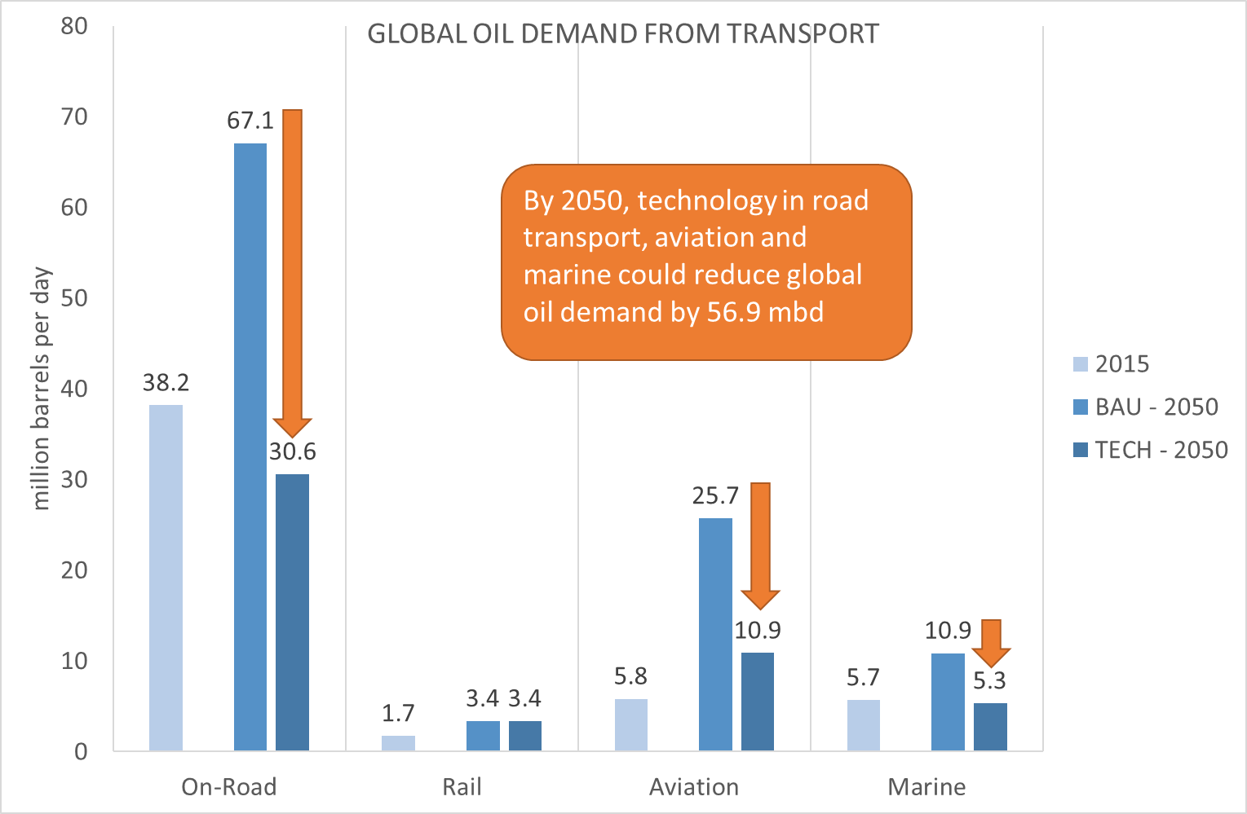

In the TECH scenario, where climate policies are being implemented to drive investment in low-carbon technologies, demand for oil will be significantly lower than in the BAU: by around 11 mbpd in 2030 and by 57 mbpd in 2050.

Slide 12
Most of the marginal mitigation to achieve 1.5DS (compared to 2DS) is in transport and industry
40-55%
(IEA, 2015; Rogelj et al., 2015; SLoCaT, 2016)
Notes:
Rogelj et al. (2015) estimated that worldwide CO2 emissions from energy and industry would have to reach zero around 2050 to stay within a 50% chance of returning warming to below 1.5°C by 2100. They estimated the need for an earlier transition to net zero carbon emissions worldwide to achieve a 2DS (when compared with other estimates), to be achieved between 2045 and 2060. For the transport sector they estimated that a 1.5DS would necessitate about 40% to 55% lower annual reductions than a 2DS
scenario.

Slide 13
Conclusions
2DS will involve stabilizing and reducing transport oil demand; 1.5DS will likely require much more–and sooner.
Immediate and sustained action is needed across all transport modes, countries, and internationally.
Transformation requires combination of innovative solutions with proven policies and technologies.
Fiscal measures including carbon, fuel and vehicle taxation complement–rather than replace–regulatory approaches.
Efficiency standards are important drivers of oil demand reductions for on-road vehicles, ships, and aircraft.
Expected demand reductions severely limit the business case for extracting oil from the Artic, many deep-water oil reserves, in-situ tar sands, and high cost offshore and shale reserves.
Lower long-term oil prices will reduce consumer energy bills and benefit the economies of oil importers.

Slide 14
Extra slides

Slide 15
Meeting global climate goals for transport requires an “all-of-the-above” approach
“Meeting long-term climate goals within the transportation sector will require strong policy action [...] including a continuation of vehicle efficiency improvements, the aggressive deployment of potentially zero-carbon vehicle technologies, and significant shifts to less energy-intensive modes, all of which can be facilitated through strong fiscal policies to help internalize the carbon impacts of transportation.”
Global Transportation Energy and Climate Roadmap (Façanha, Blumberg & Miller, 2012)

Slide 16
IAMs reach 450 ppm CO₂ w/ escalating carbon prices
Notes:
IA models tend to use escalating carbon prices to achieve emissions constraints or end-of-century targets
These models provide insights not only on the method of mitigation, but the price needed to attain it
Reduce pre-mature retirement of existing energy-intensive capital
Take advantage of future technological changes between now and 2100
$100/ton CO2 = 89 cents/gallon gasoline

Slide 17
CO₂ reductions achievable with “world-class” policies are evenly split between LD and HD sectors
Direct combustion CO₂ emissions of light- and heavy-duty vehicles, 2005-2040. Historical and projected emissions for Australia, Brazil, Canada, China, EU-28, India, Japan, Mexico, United States, and Russia.
Notes:
Policies already adopted by TTG members are expected to reduce 2 GtCO2 per year in 2040, with fuel savings of 15 mb/d (compared to a baseline without these policies).
LDVs account for about 80% of these benefits.
Additional reduction of 2.4 GtCO2/year in 2040 (16 mb/d) is achievable with new policies (“World-class” scenario).
Evenly split between LD and HD sectors.
“World-class” vehicle efficiency standards could stabilize CO2 from LDVs and HDVs in the 2020-2030 timeframe and reduce absolute emissions through 2040.
Magnitude of cost effective mitigation potential indicates vehicle efficiency should play a greater role in countries’ future INDCs and climate actions
Even at a low oil price of 50 USD/barrel, the direct annual savings to consumers and freight operators with these new policies could be on the order of $290 billion in 2040.

Slide 18
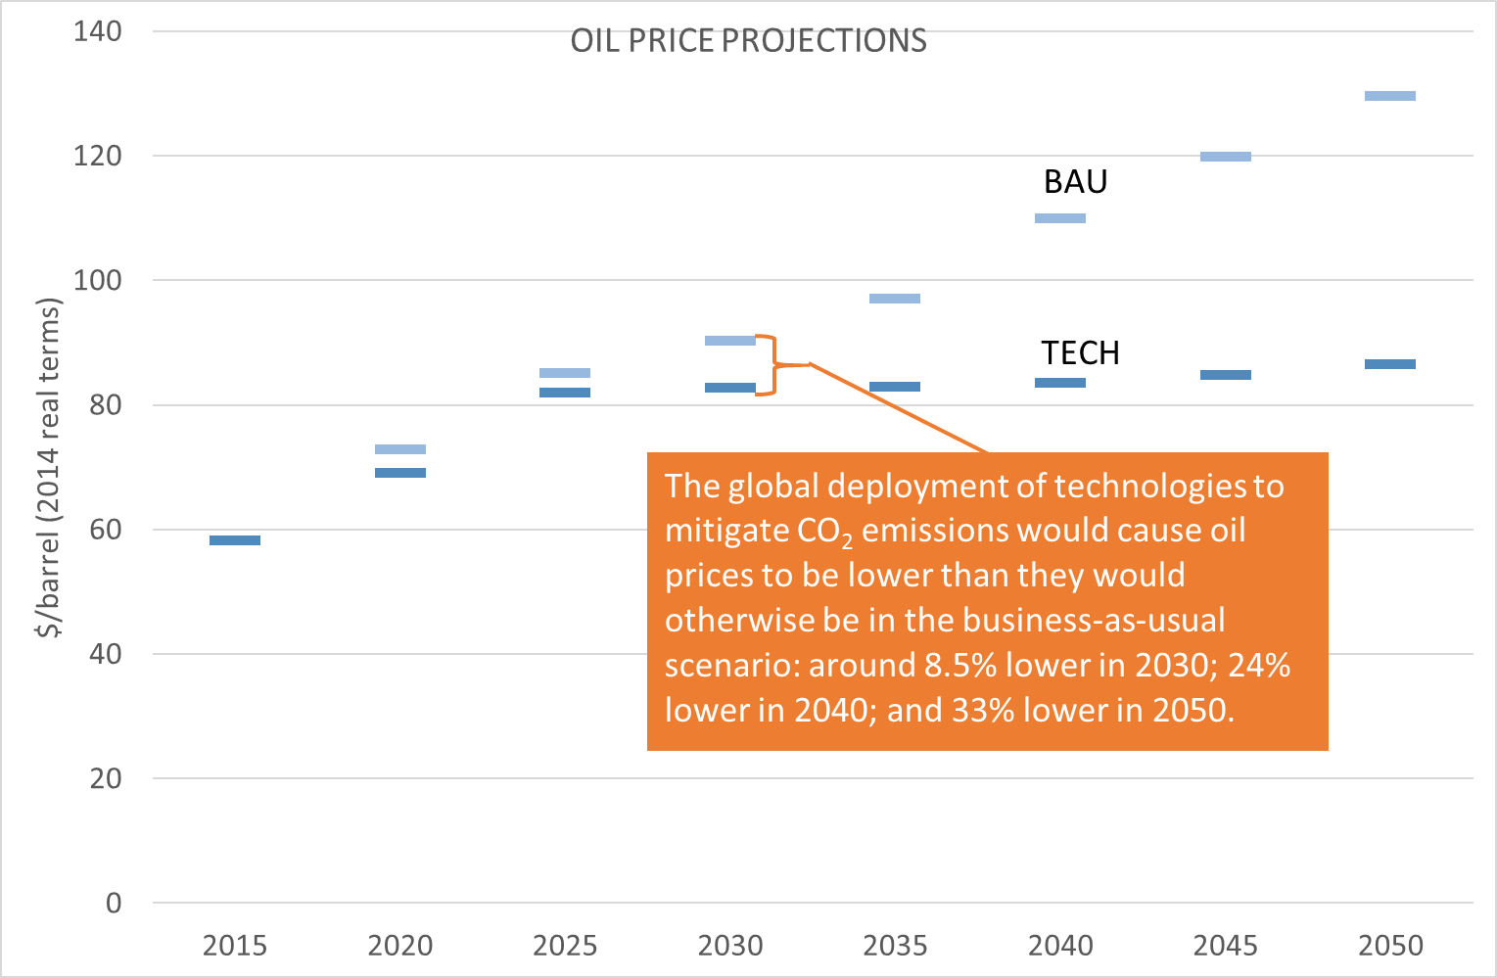
The reduction in demand delays the need to invest in extracting increasingly expensive oil from non-conventional sources, and the long-term market price of oil would settle around a stable band between $83 and $87 per barrel from 2030 to 2050.

Slide 19
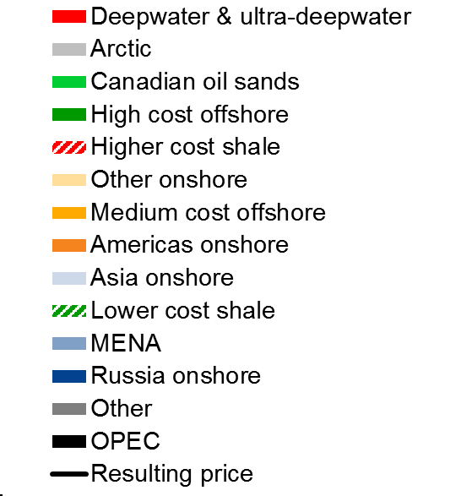
At the price point projected in the Technology Potential scenario, it would not be profitable to extract oil from the Artic; from many deep-water oil reserves; as well as from in-situ tar sands and higher cost offshore and shale.

Slide 20
Paris Agreement objective to limit warming to well below 2°C will involve policies in the “Efficient transport” scenario and more.
Effect | Business as usual (BAU) | Efficient transport (TECH)
Medium-term oil prices | Prices likely recover to reflect marginal cost of oil production at ~$80/bbl in 2020-2025. | Prices likely recover to slightly lower levels reflecting lower oil demand.
Transport oil demand | ~2x current levels in 2050 | ~1x current levels in 2050
Total oil demand (all sectors) | 151 mb/d in 2050 (+ 60%) | 94 mb/d in 2050 (+ 0%)
Long-term cost of production | Increases to $130-$140/bbl | Stabilizes at $80-87/bbl
Impact of oil prices on GDP | – | 0.5% net GDP increase in US and EU compared to BAU
Oil exploration and production | Increases in Arctic, ultra-deep, tar sands and heavy oils | Arctic and ultra-deep not viable; limited tar sands/heavy
Climate pathway | Likely greater than 4 degrees | Closer to 2 degrees
Source: Oil market futures
Notes:
In our baseline scenario, we forecast oil prices to rise steady to meet growing demand, hitting $130/barrel in 2050 (2014 USD).
In our TECH scenario, we find substantial potential for oil savings from the transportation sector with adoption of efficiency standards and policies to accelerate penetration of electric vehicles. We estimate that projected transport oil demand could be cut in half, holding transport oil demand constant at current levels.
Comparing the BAU and TECH scenarios, we find that global oil prices can be contained in the mid- $80/barrel, which would also limit some of the more energy intensive types of oil extraction. This would result in a 24% cut in oil prices in 2040, and a third lower in 2050.
We find substantial economic benefits associated with the vehicle efficiency policies in the TECH scenario. We estimate that global annual oil expenditures could be reduced by $330 billion – on average – from 2020 to 2030. In the US, we estimate a half percent increase in GDP in 2050, and an increase of more than 170,000 jobs.

